Slide 1

An NSS Audio-Visual
Library Presentation
The Best of the
1991 NSS Photo Salon
National Speleological Society
S914 81 Slides 2/23/2021

Slide 2
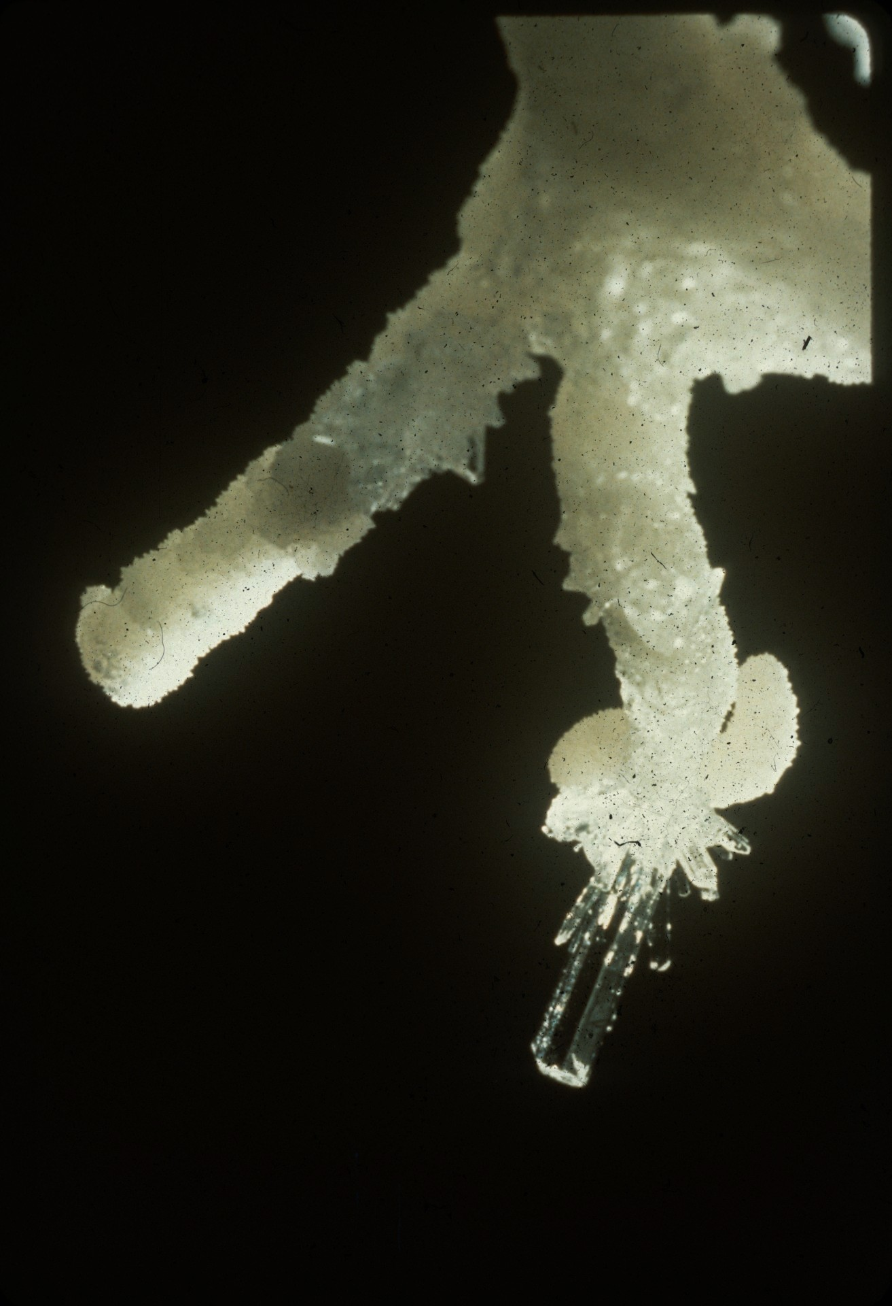
Notes:
Mystery Cave – Peter and Ann Bosted

Slide 3
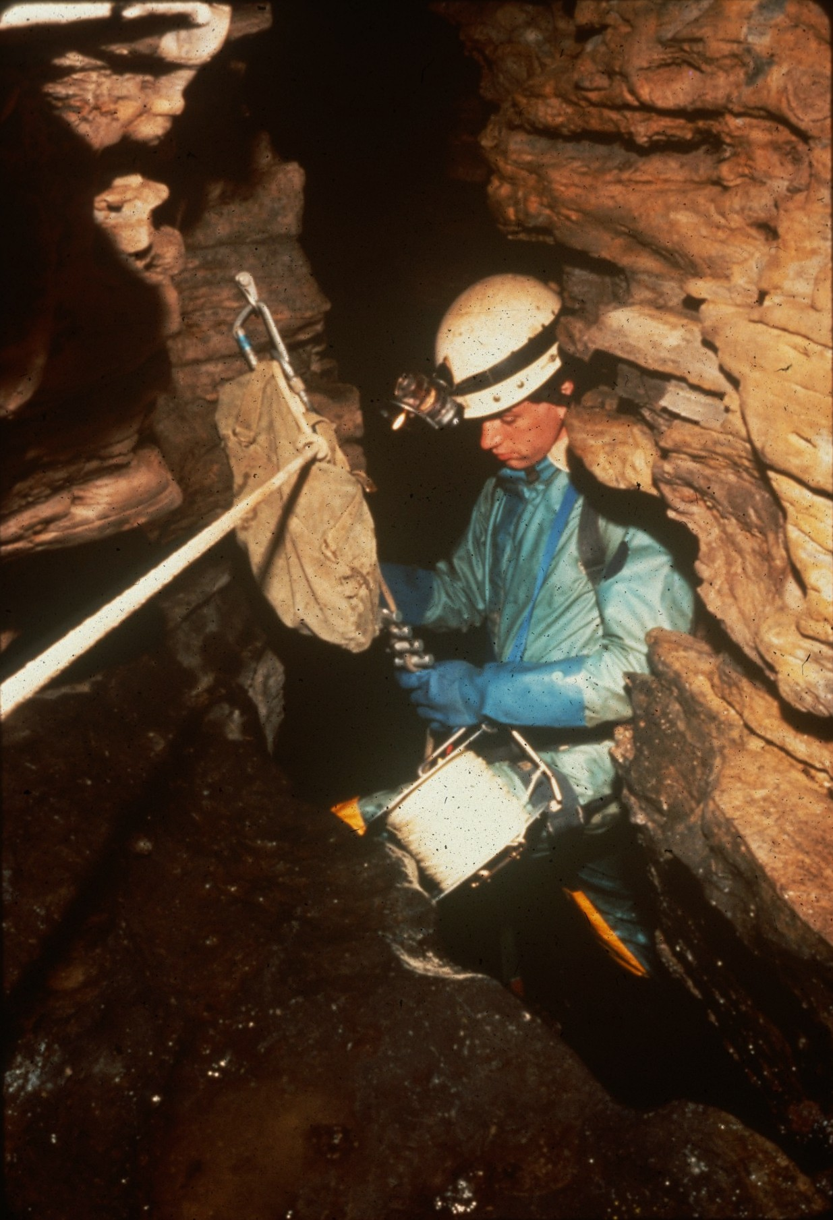
Notes:
Rappeller – Ron Simmons

Slide 4
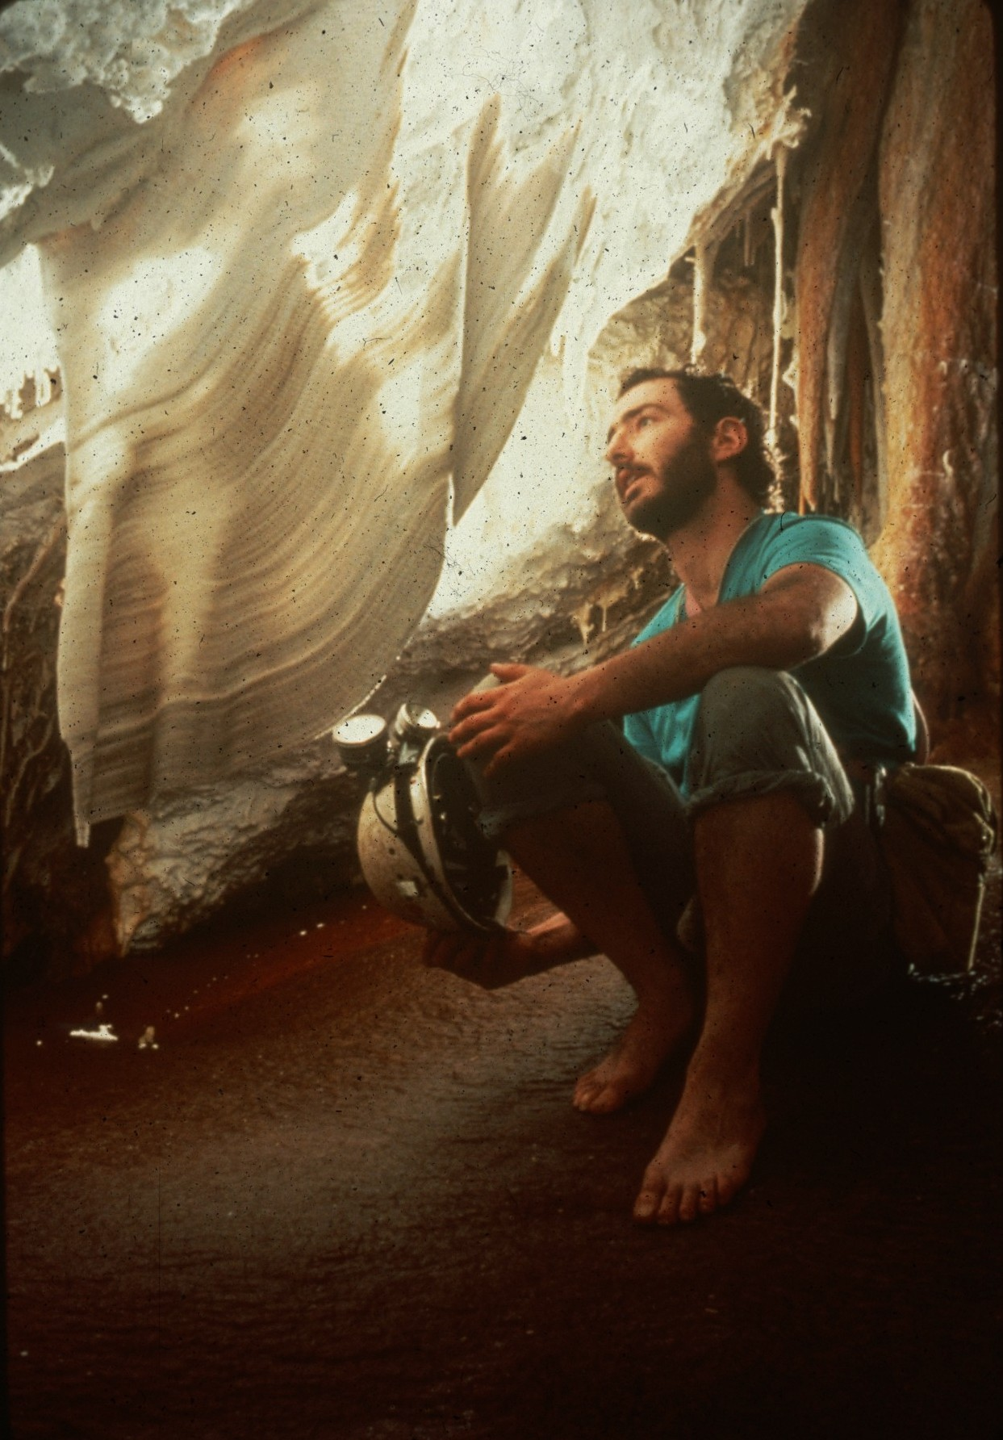
Notes:
It Could Be Porcelain – Peter and Ann Bosted

Slide 5
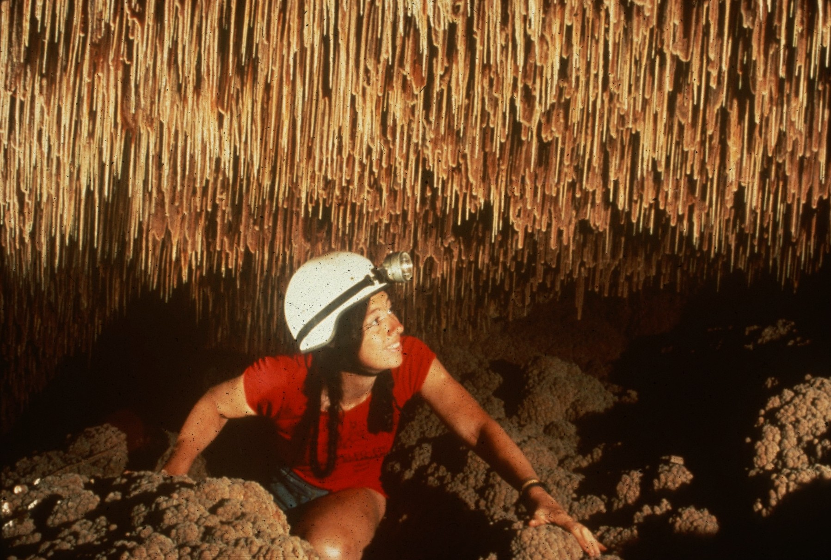
Notes:
Below “The Pool Fingers” – Peter and Ann Bosted

Slide 6
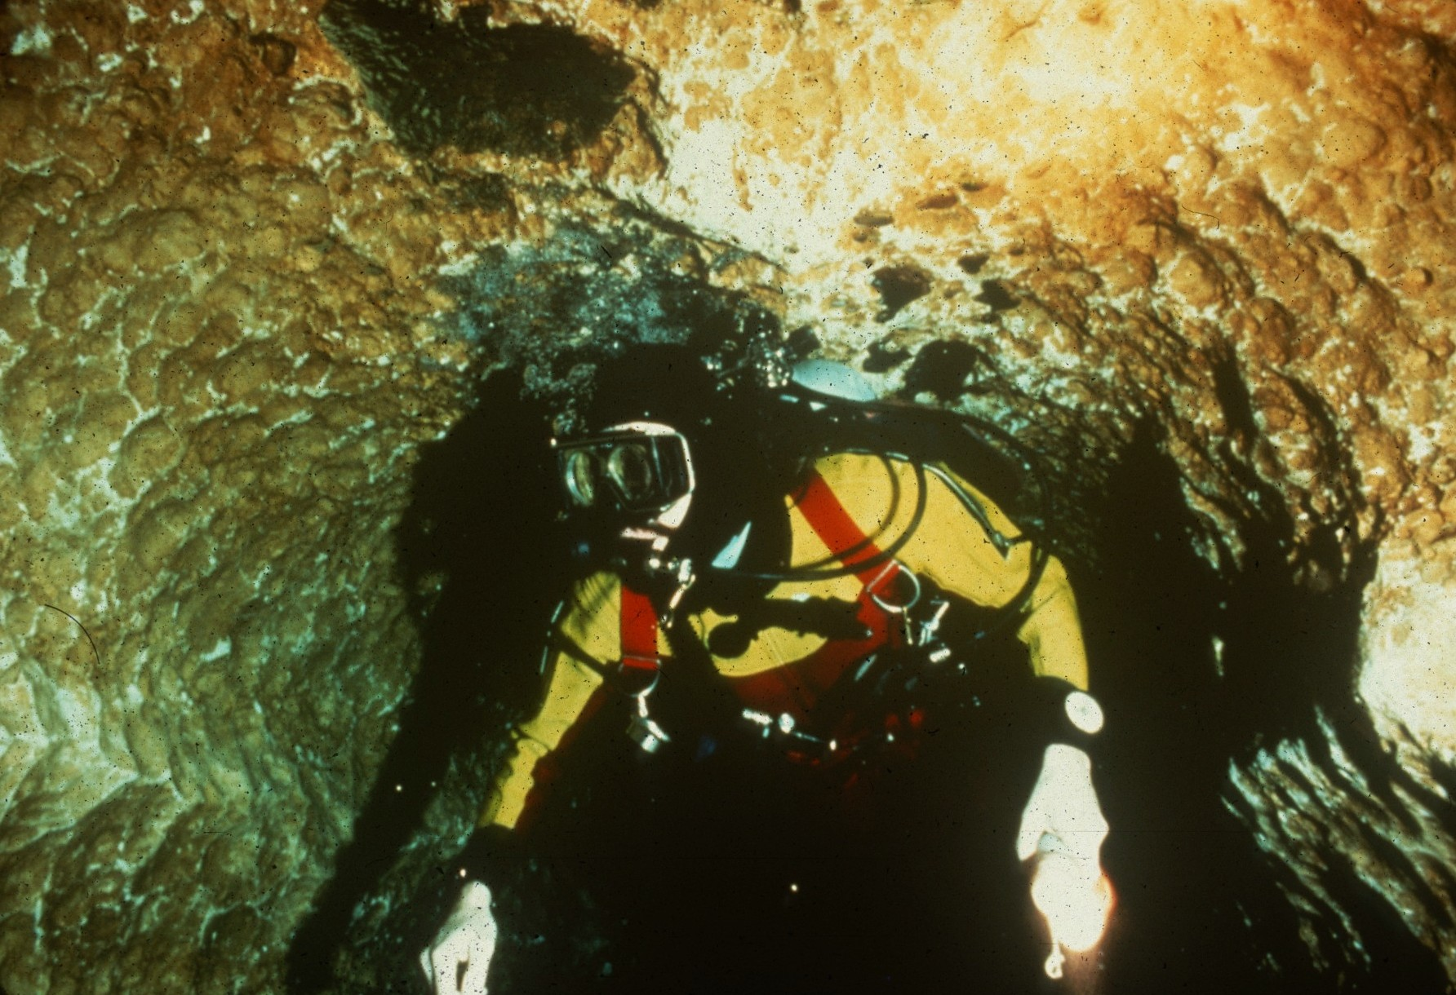
Notes:
Little River Tunnel – Kevin Downey

Slide 7
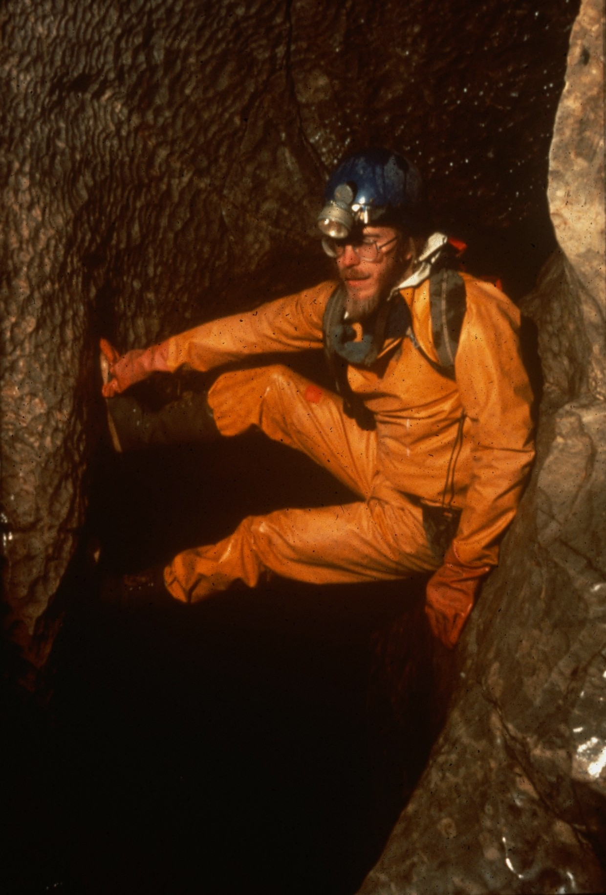
Notes:
Peter Bosted in Rudiche Propodani, Morauski Kras, ZA – Kevin Downey

Slide 8
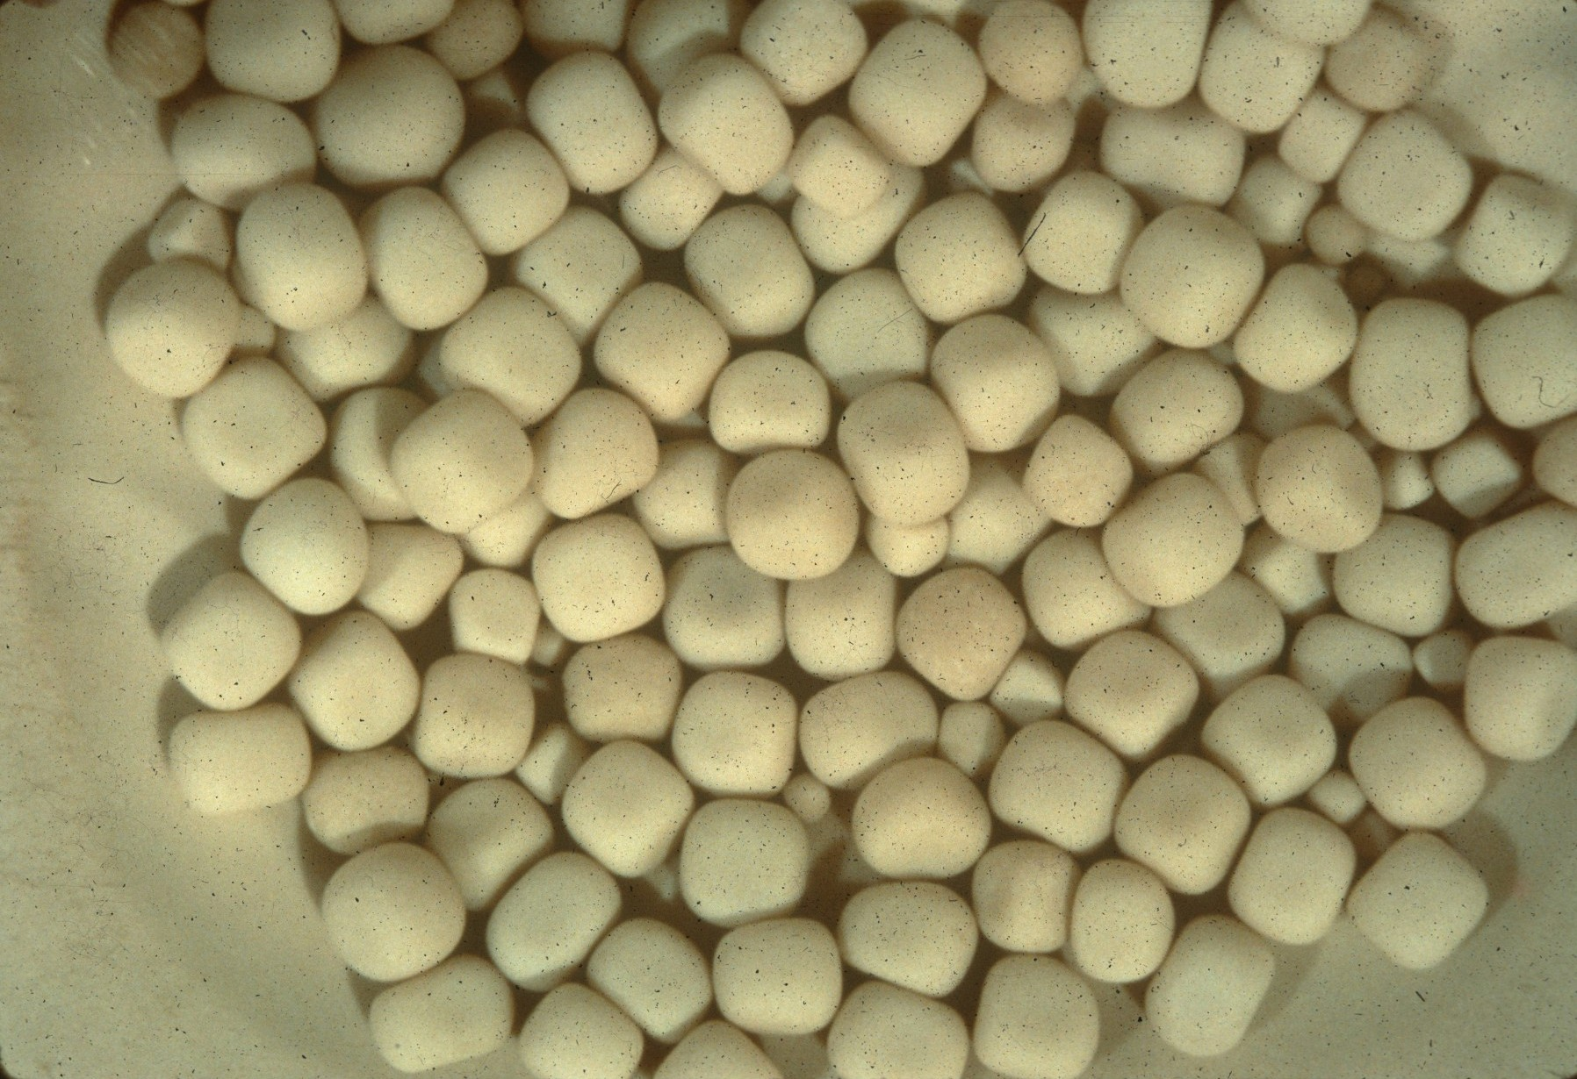
Notes:
Cubics – Ron Simmons

Slide 9
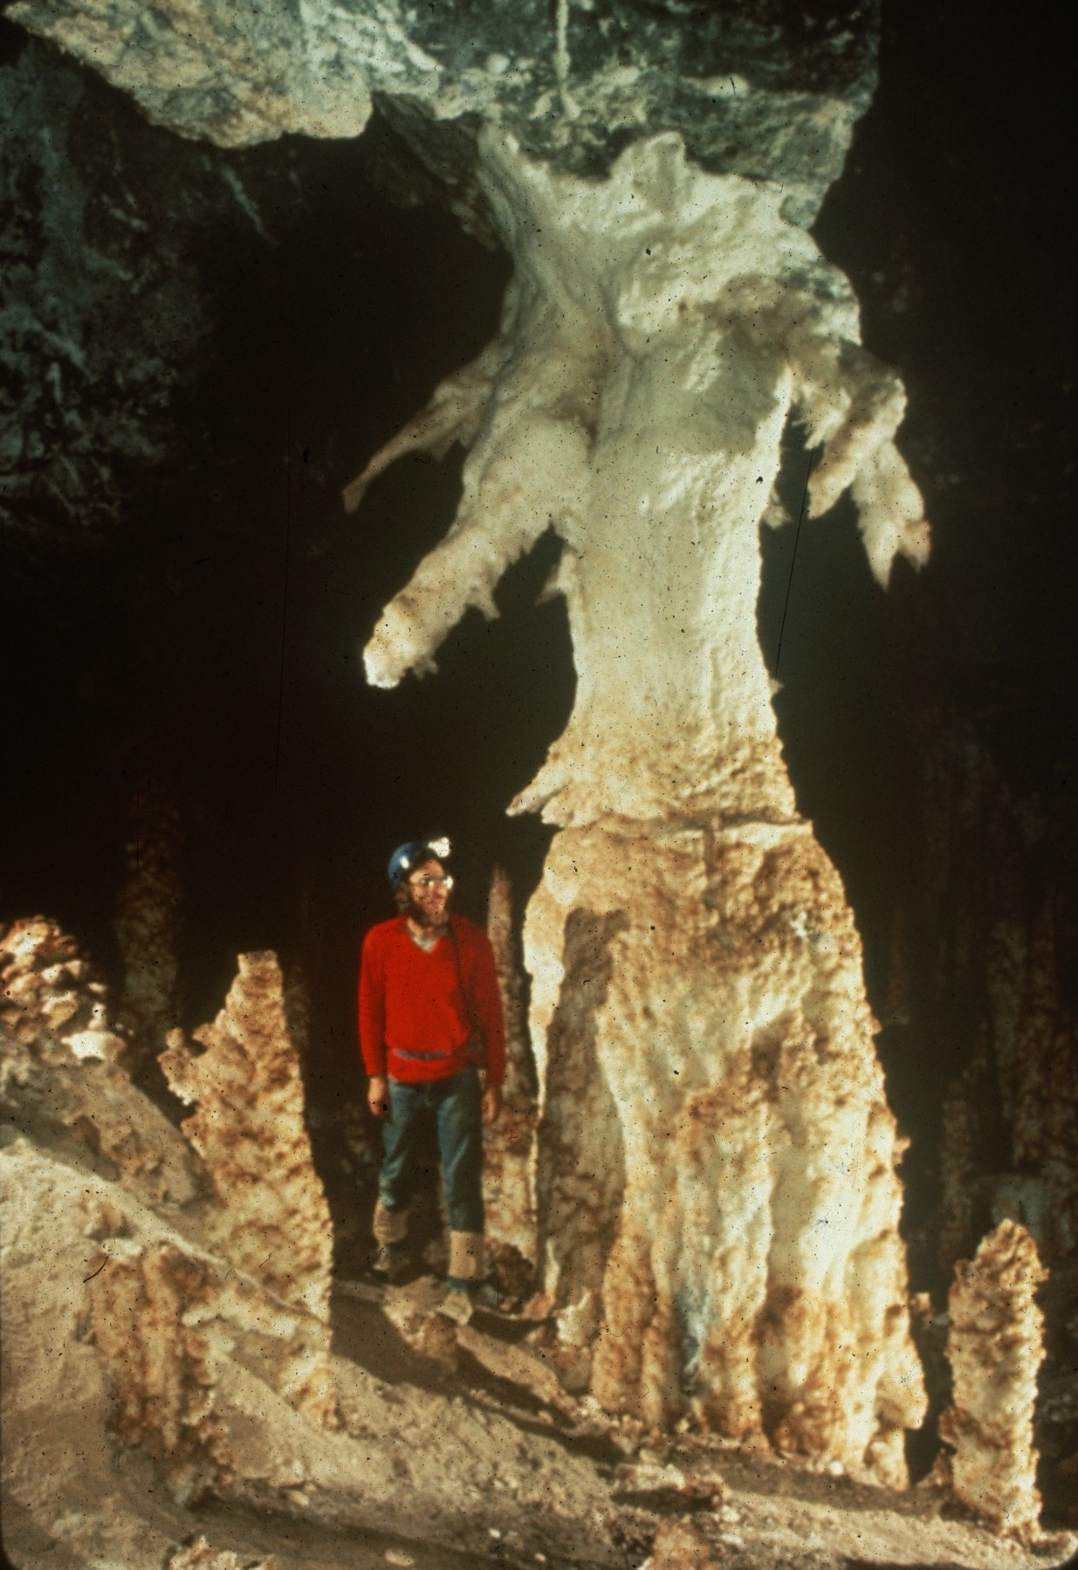
Notes:
Gypsum Stalagmites in Turkmenia – Peter and Ann Bosted

Slide 10
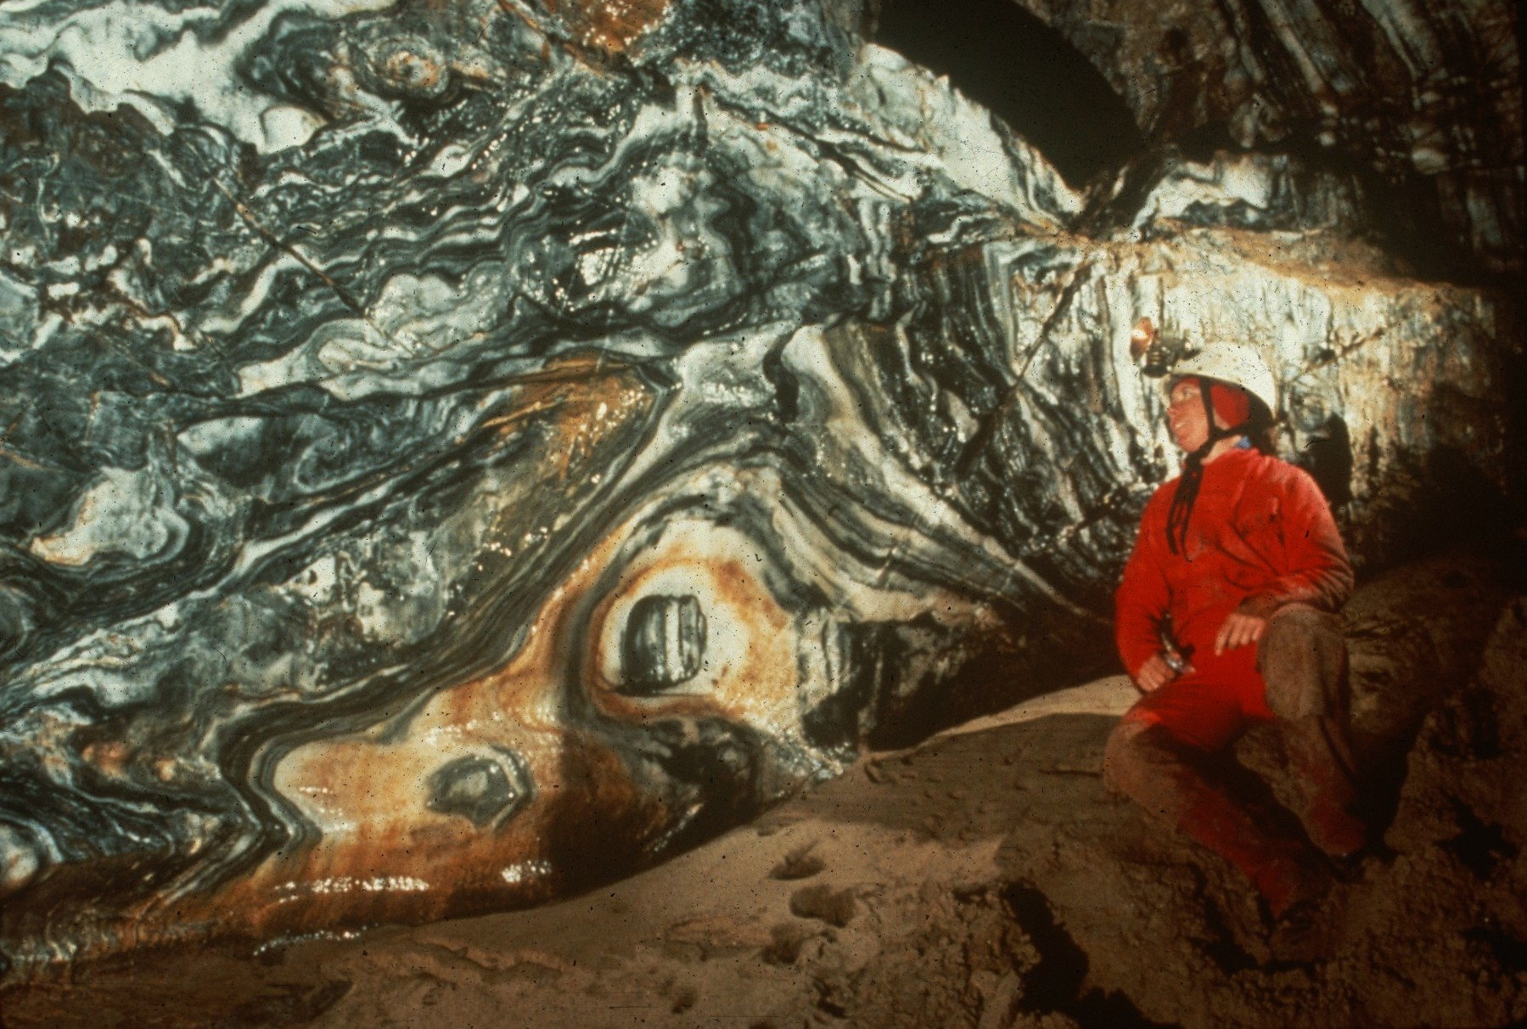
Notes:
Big Brother’s Watching – Peter and Ann Bosted

Slide 11
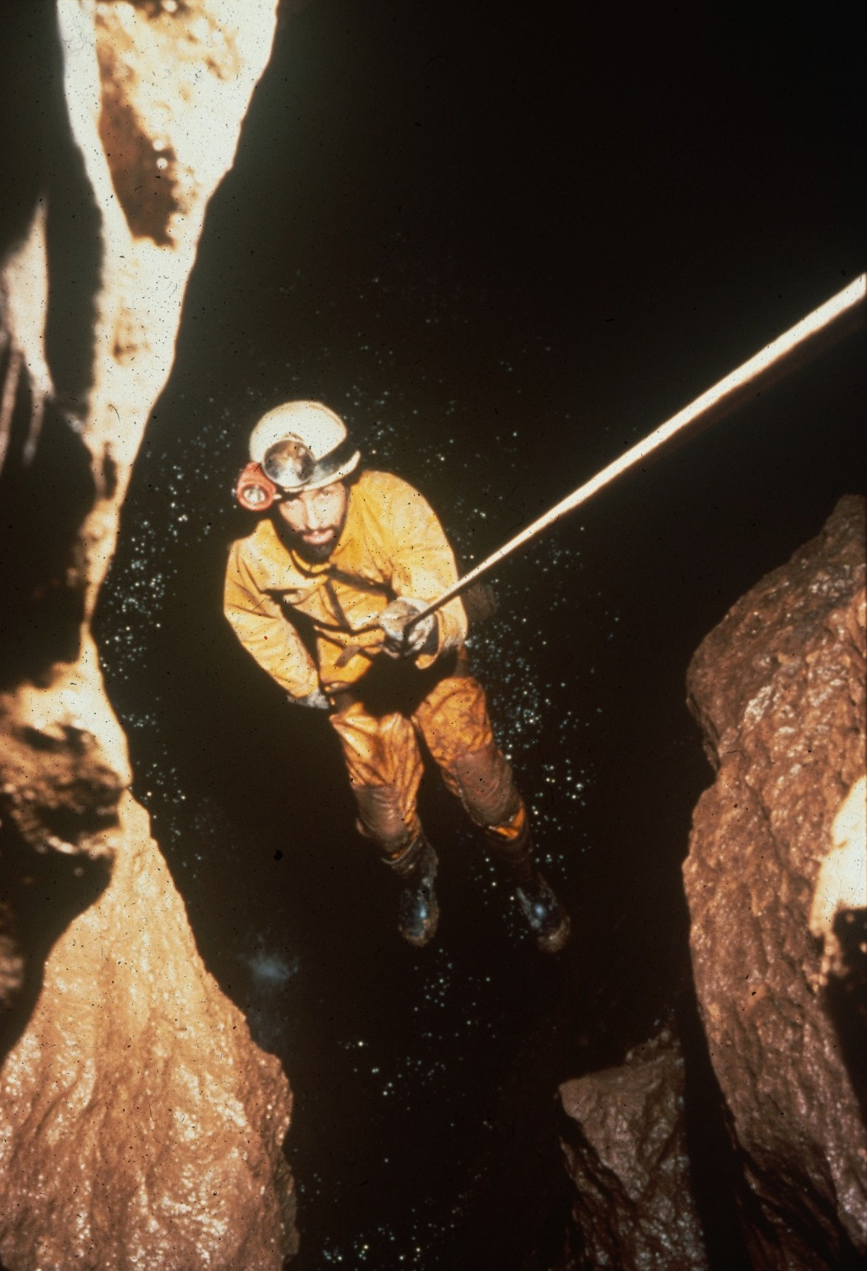
Notes:
Into the Depths – Ron Simmons

Slide 12
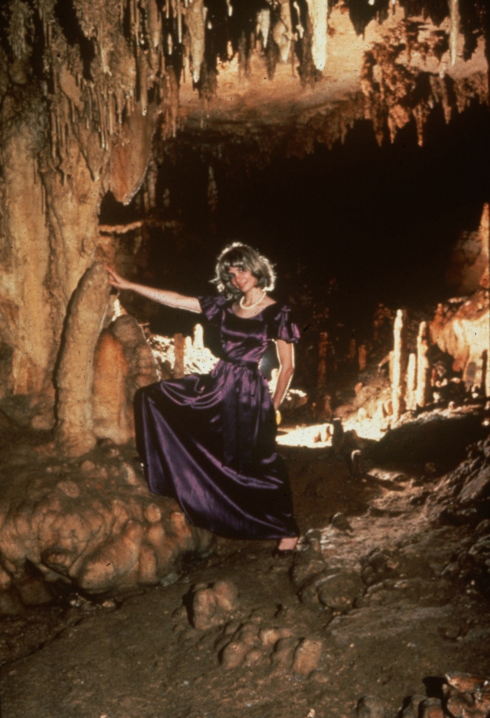
Notes:
My Fair Lady – John Van Swearingen, IV

Slide 13
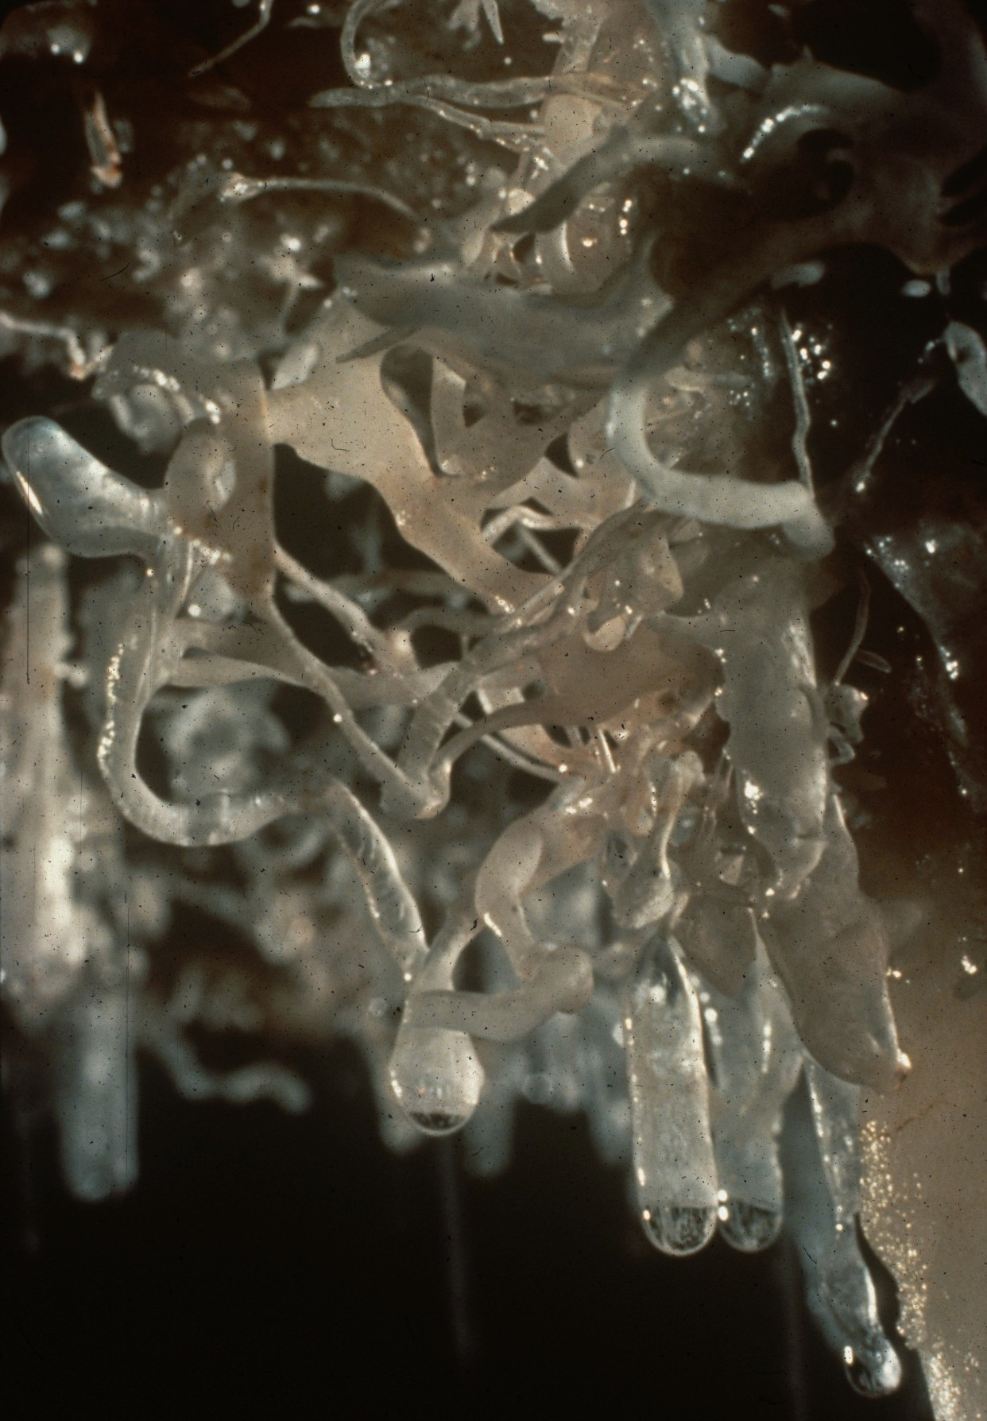
Notes:
Confusion – Roland Browne

Slide 14
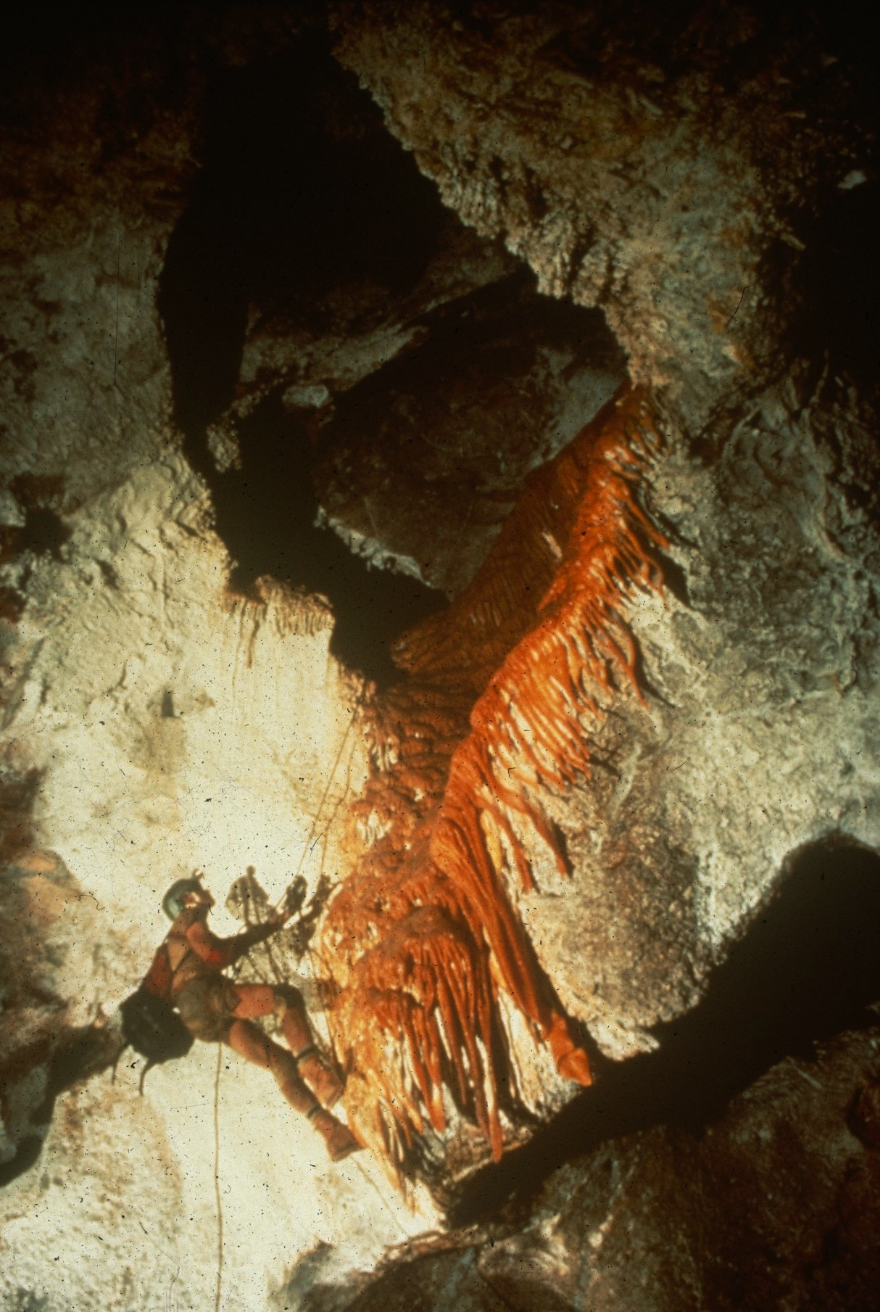
Notes:
Into Firefall Hall – Norman Thompson

Slide 15
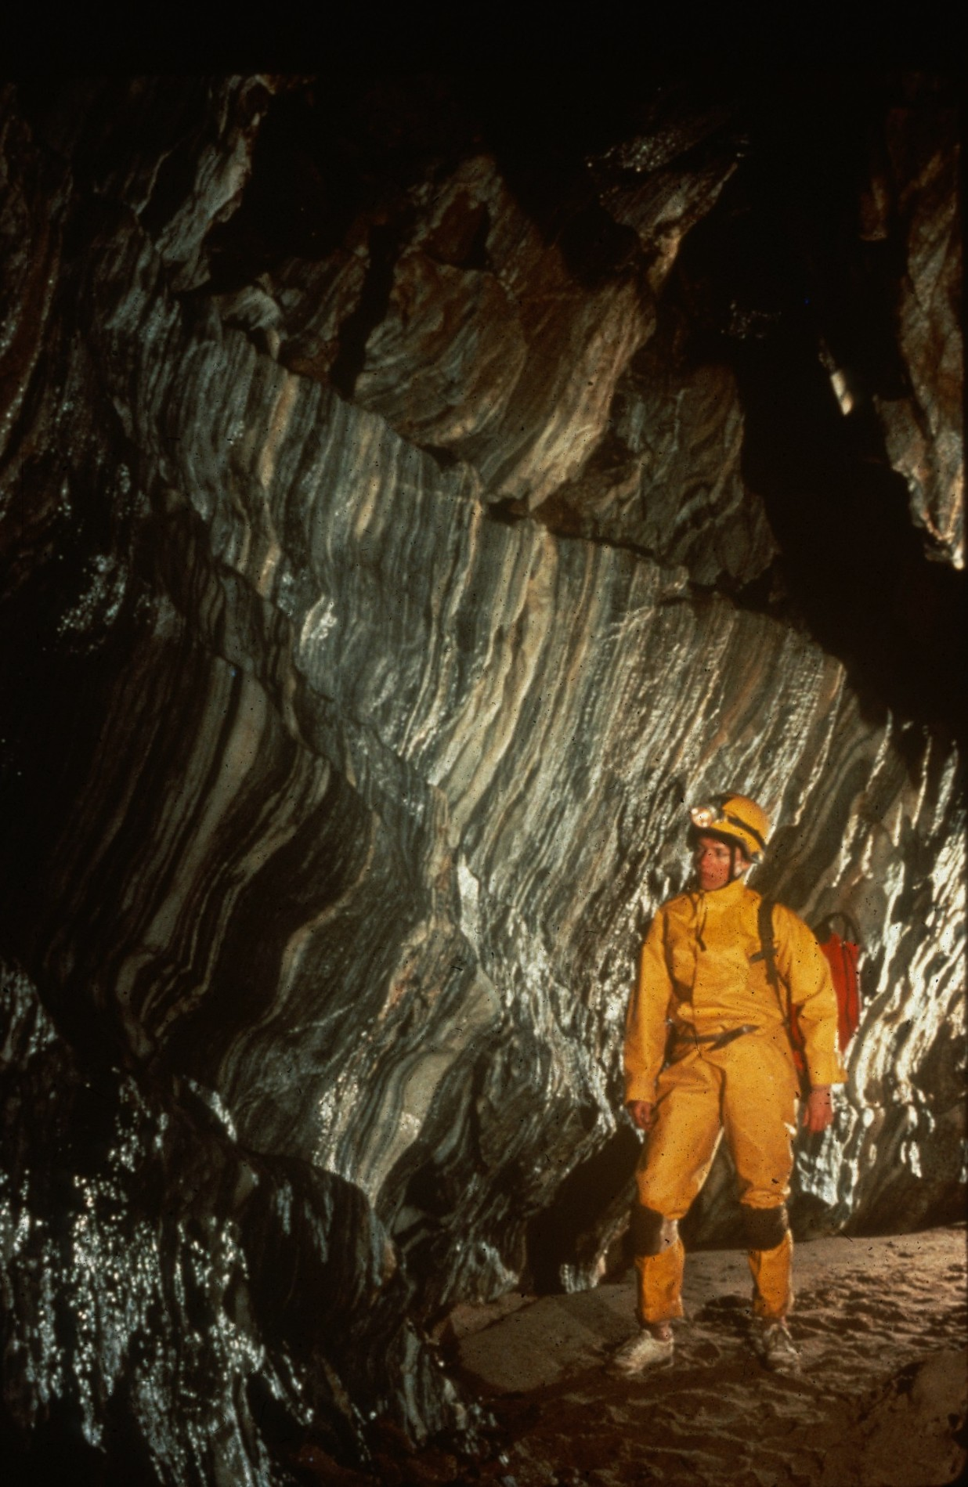
Notes:
Marble Bands of Black and White – Peter and Ann Bosted

Slide 16
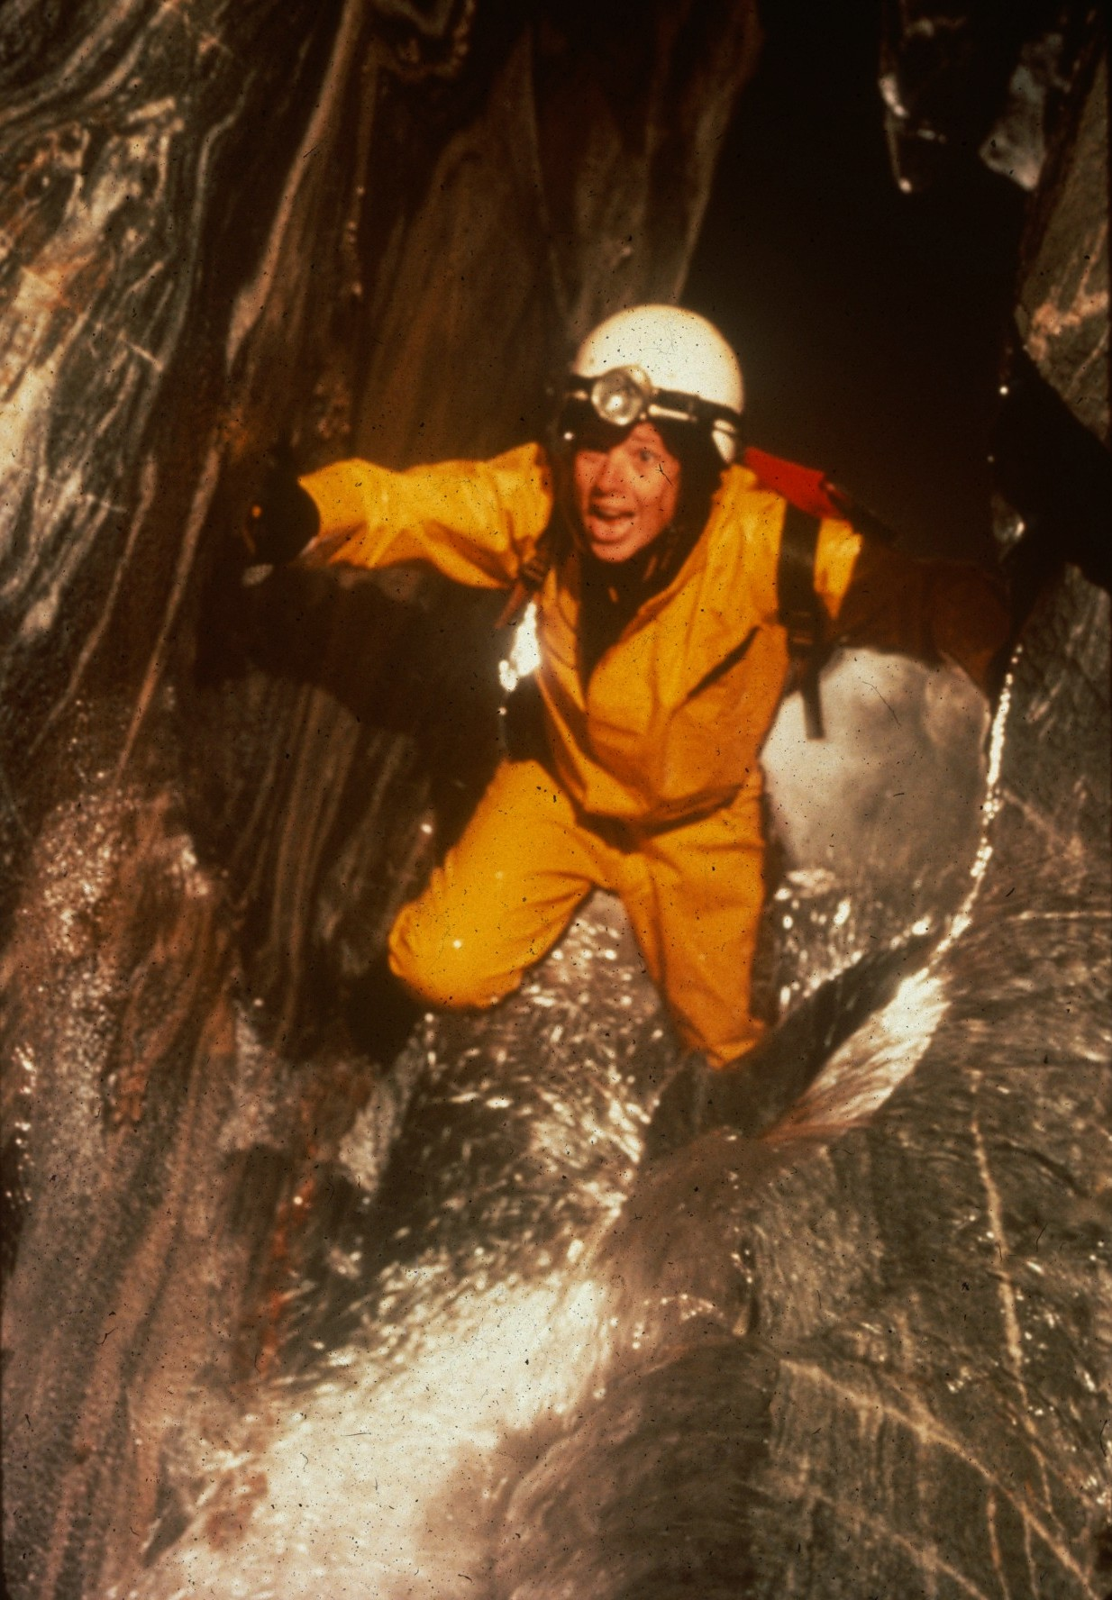
Notes:
Water Tumbles, Cavers Don’t – Peter and Ann Bosted

Slide 17
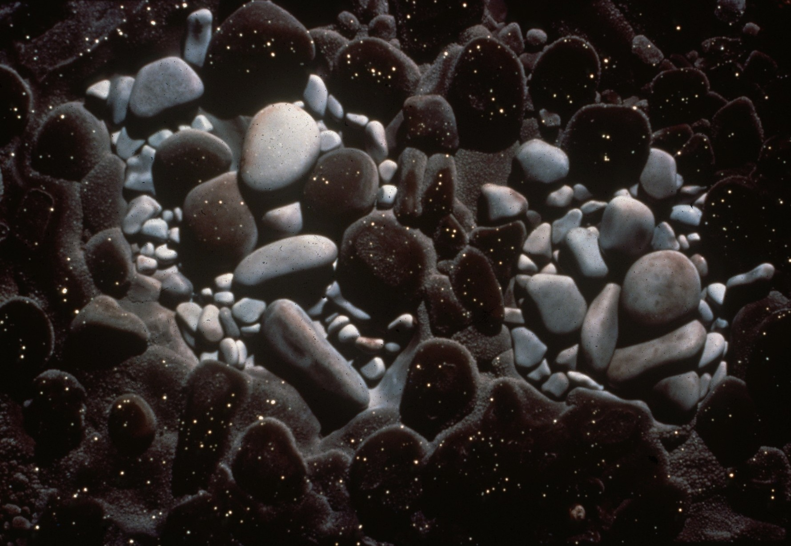
Notes:
Sparkles – Roland Browne

Slide 18
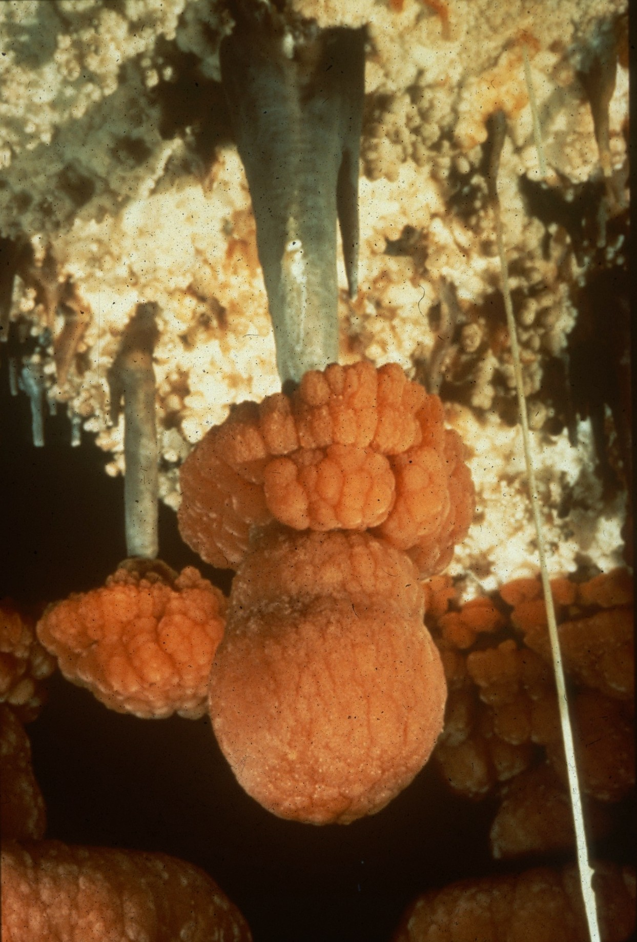
Notes:
Grand Pendant – Kevin Downey, Sura Ballman, and Urs Widmer

Slide 19
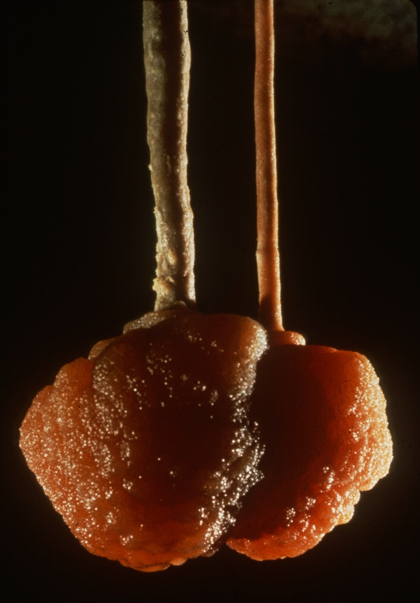
Notes:
Too Close to Grow Apart – Peter and Ann Bosted

Slide 20
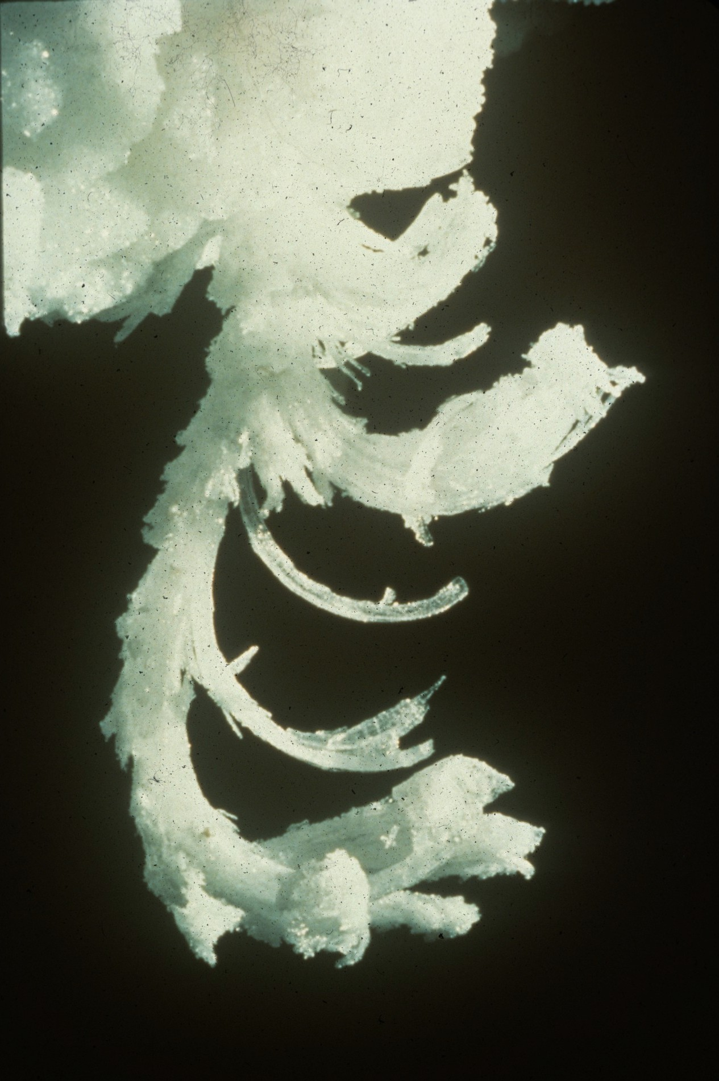
Notes:
Gypsum Leaves – Norman Thompson

Slide 21
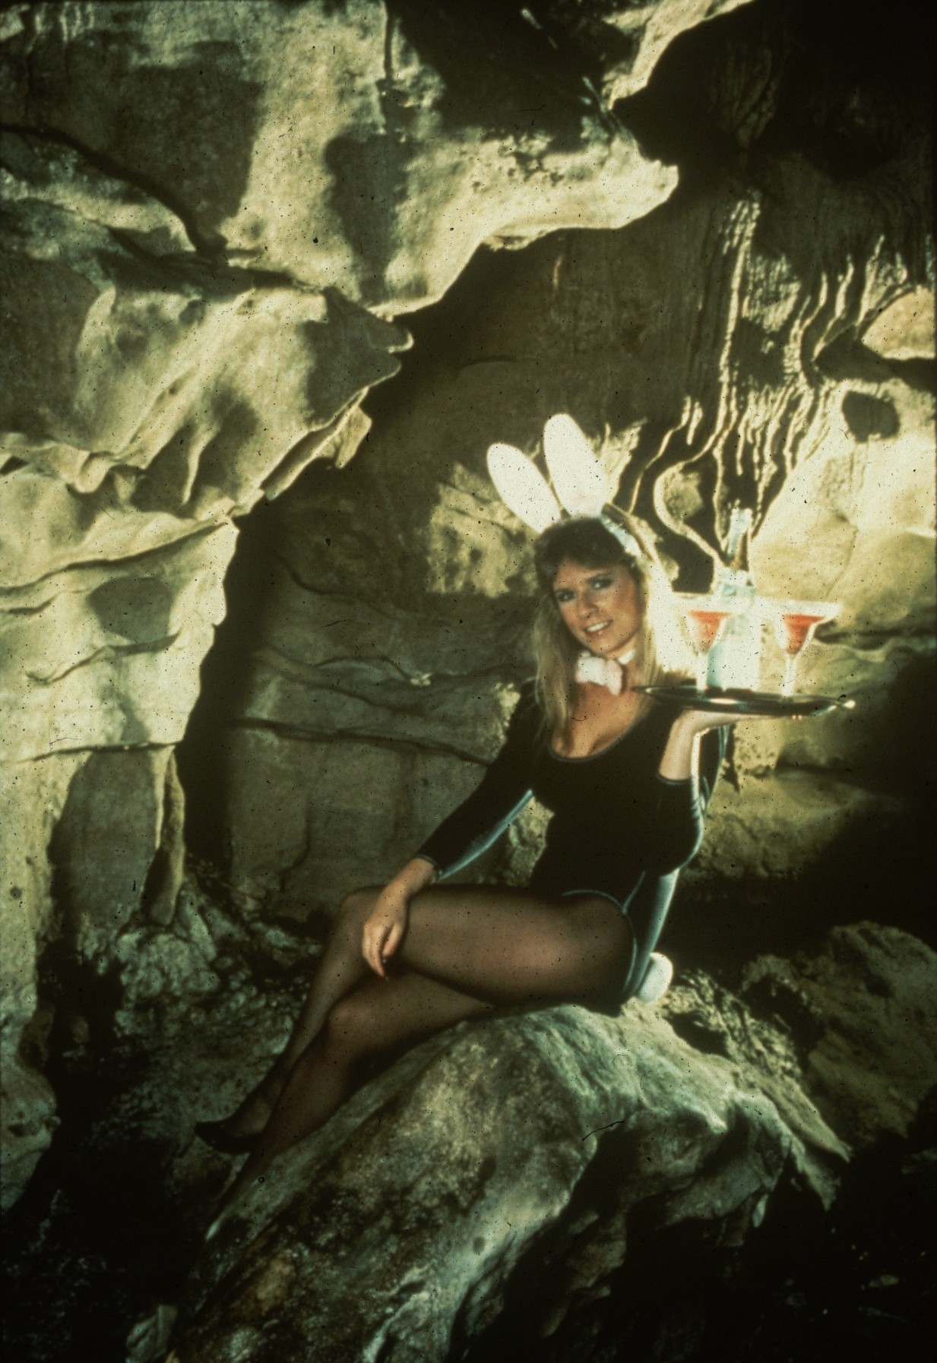
Notes:
Of Course We Accept NSS Gold Visa – John Van Swearingen, IV

Slide 22
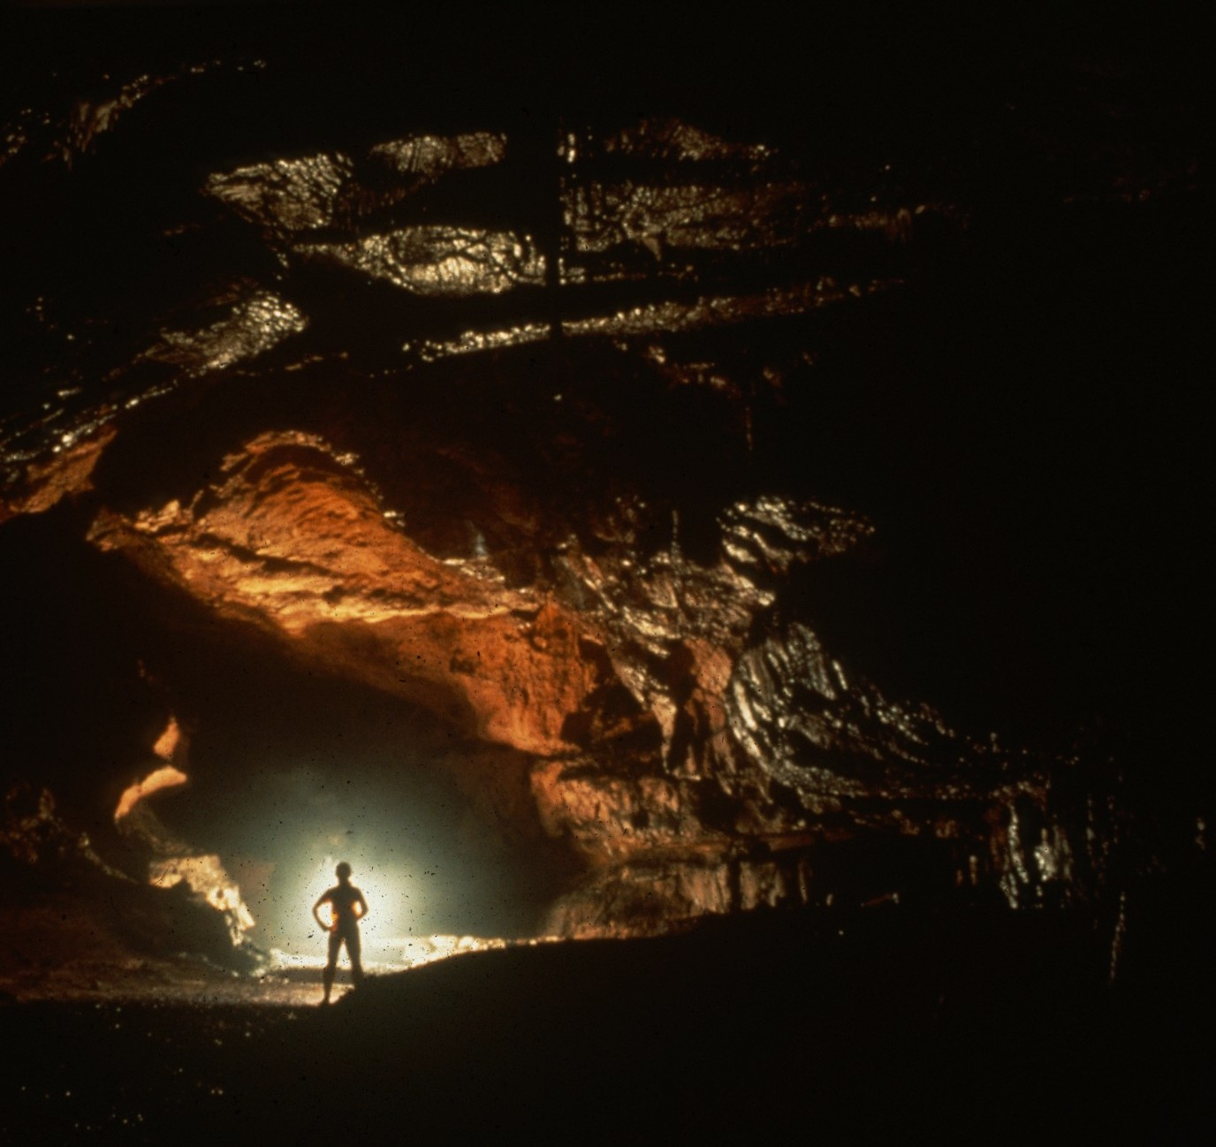
Notes:
Baradla Barlang, Aggelek, Hungary – Kevin Downey

Slide 23
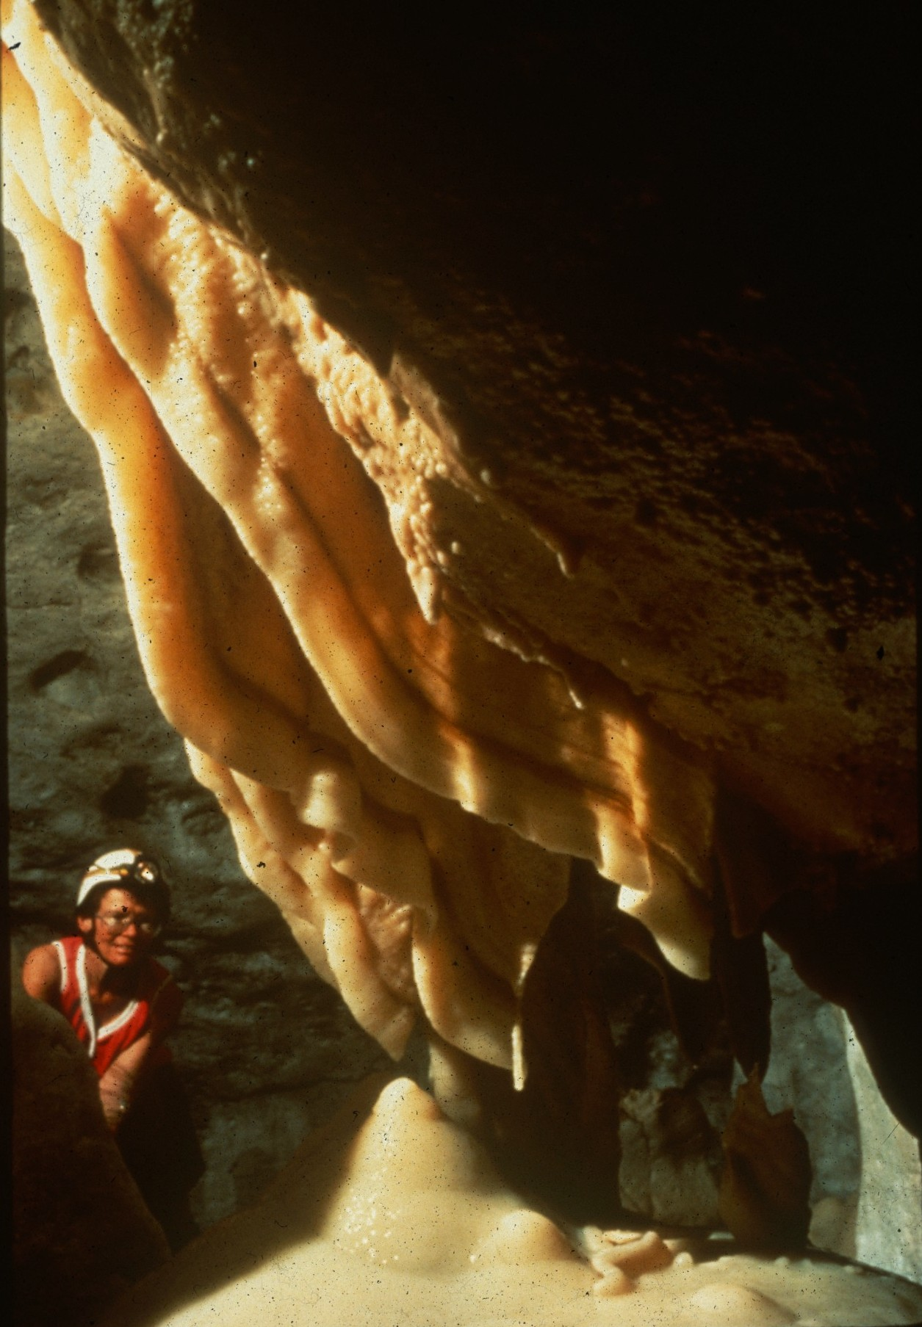
Notes:
Giant Chicklet Draperies – Norman Thompson

Slide 24
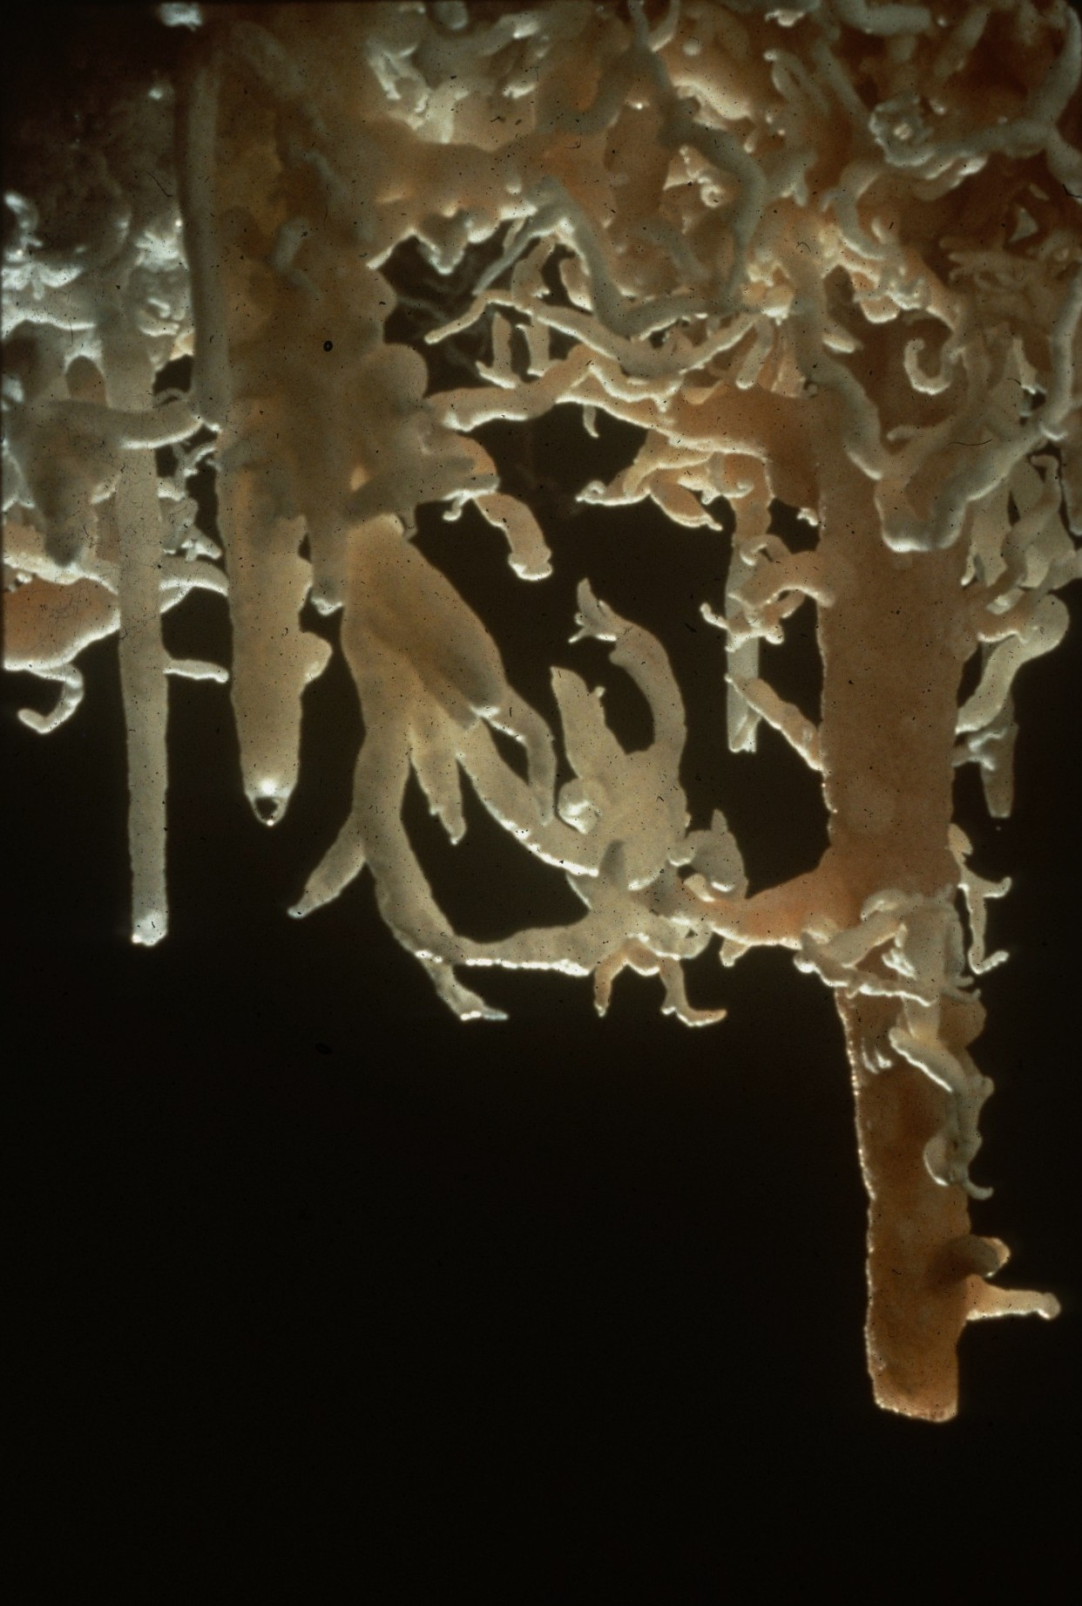
Notes:
A Tangle in Turkmenia – Peter and Ann Bosted

Slide 25
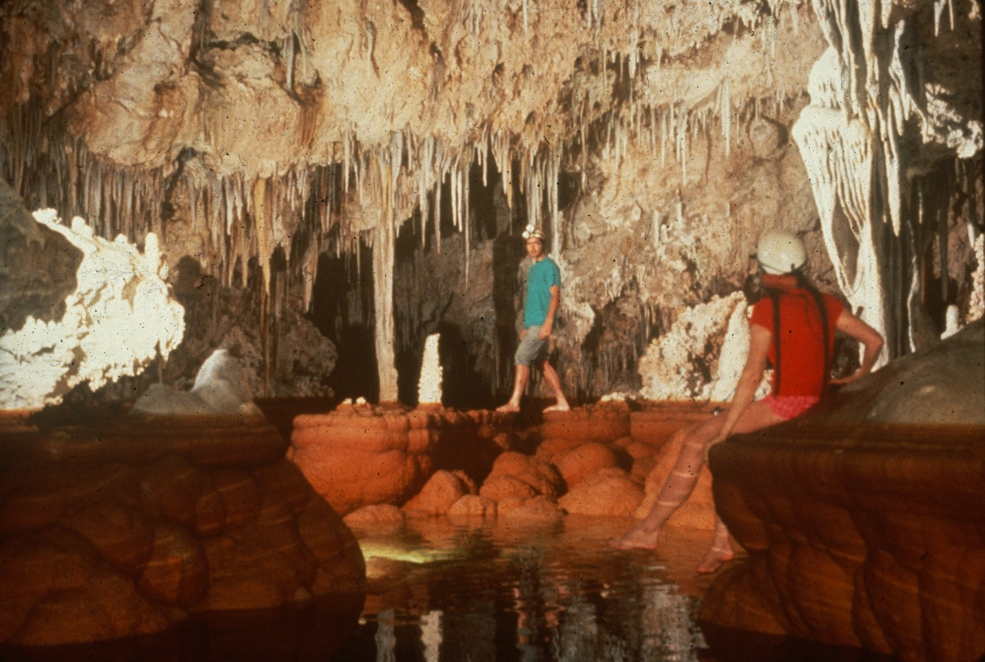
Notes:
A Shared Moment – Peter and Ann Bosted

Slide 26
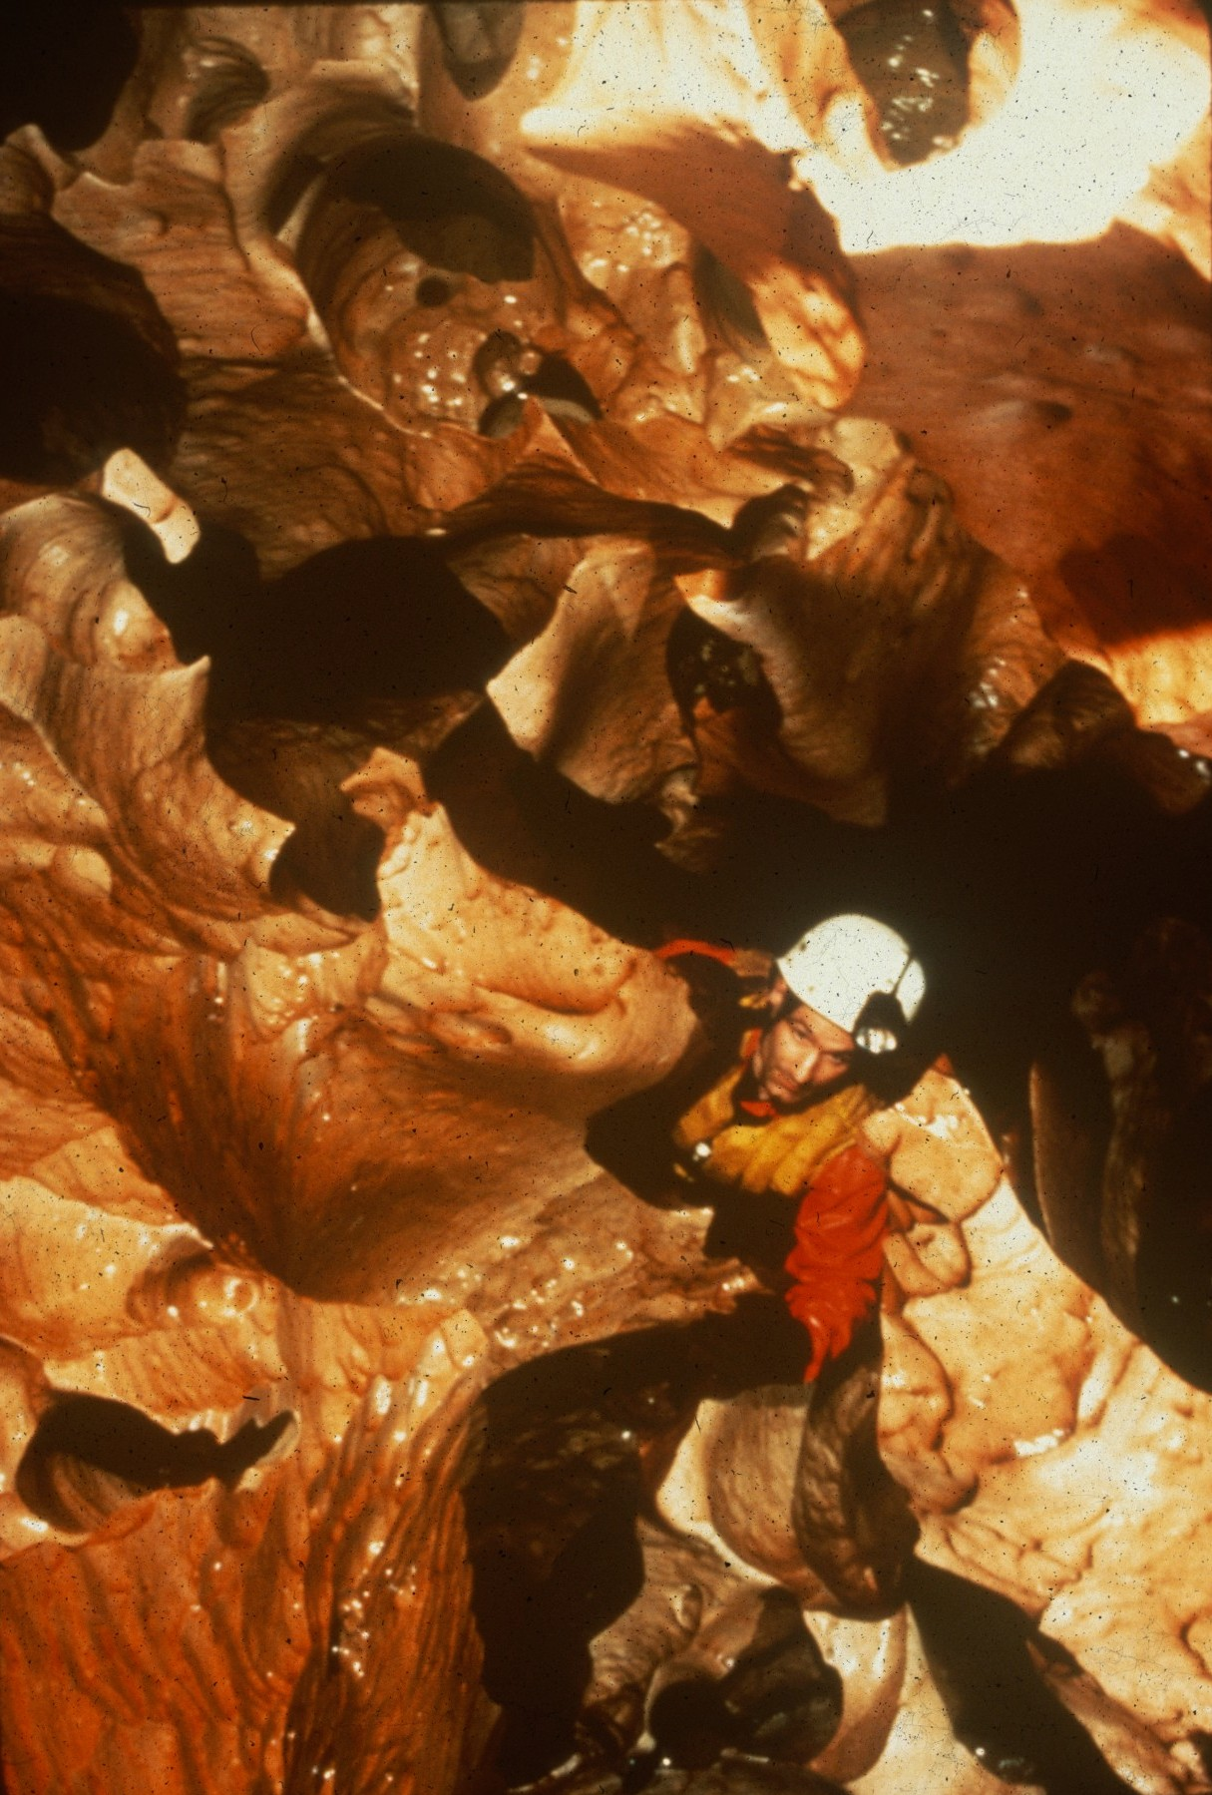
Notes:
Swiss Cheese in Cueva Zumbo – Kevin Downey

Slide 27
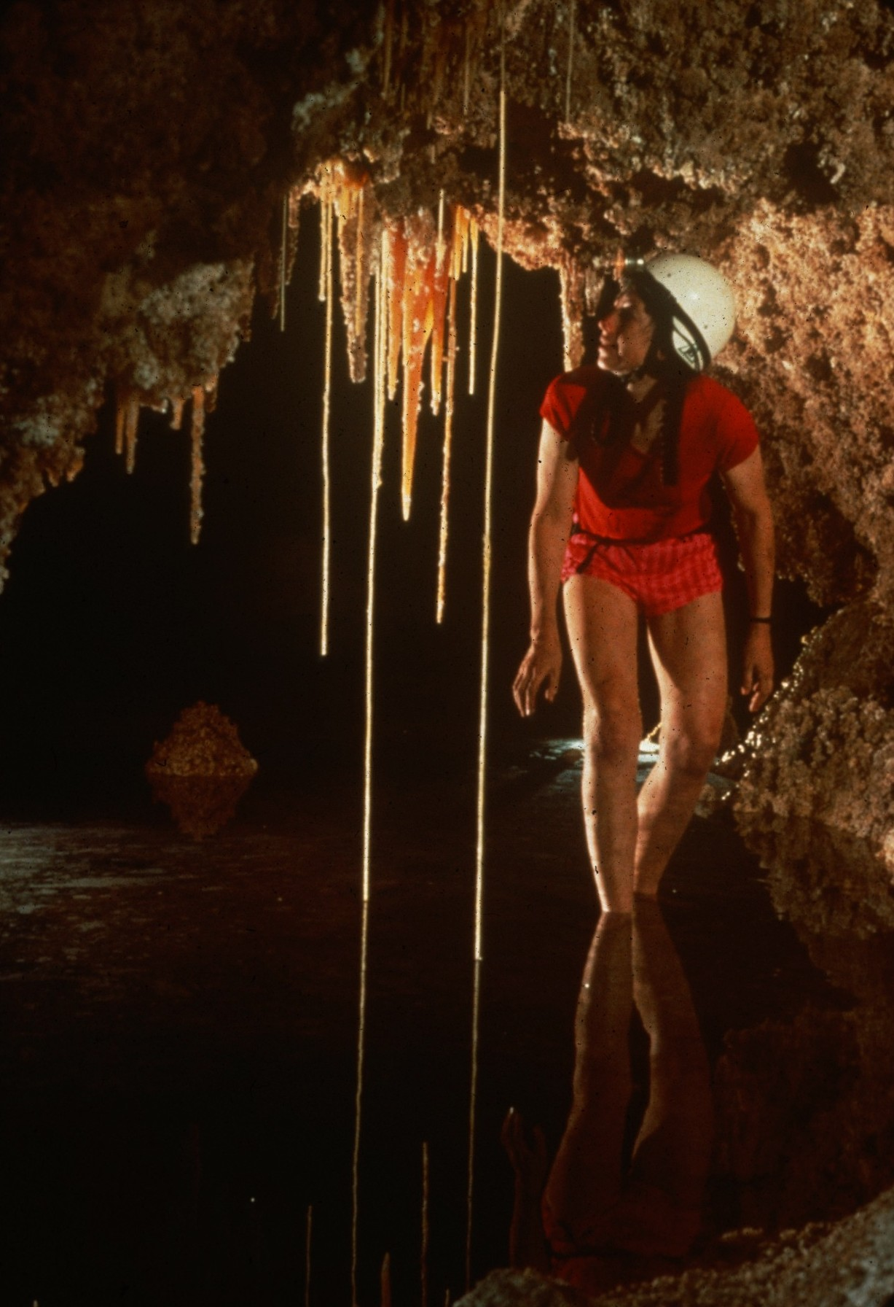
Notes:
Where the Waves Can Kill – Peter and Ann Bosted

Slide 28
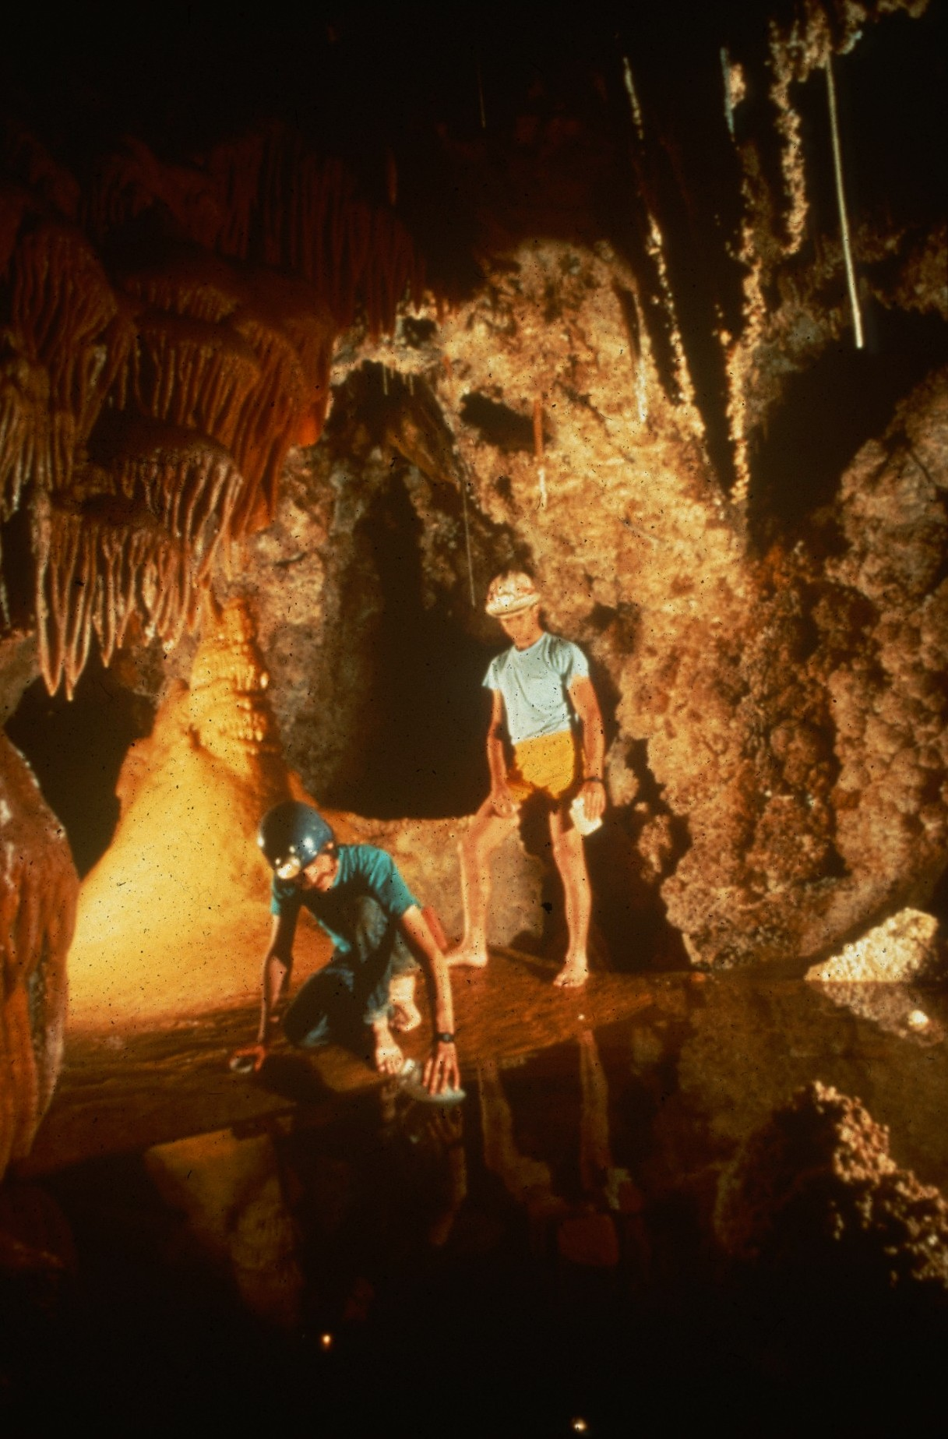
Notes:
Jake Turin and John Hymer in the Red Lake Room – Norman Thompson

Slide 29
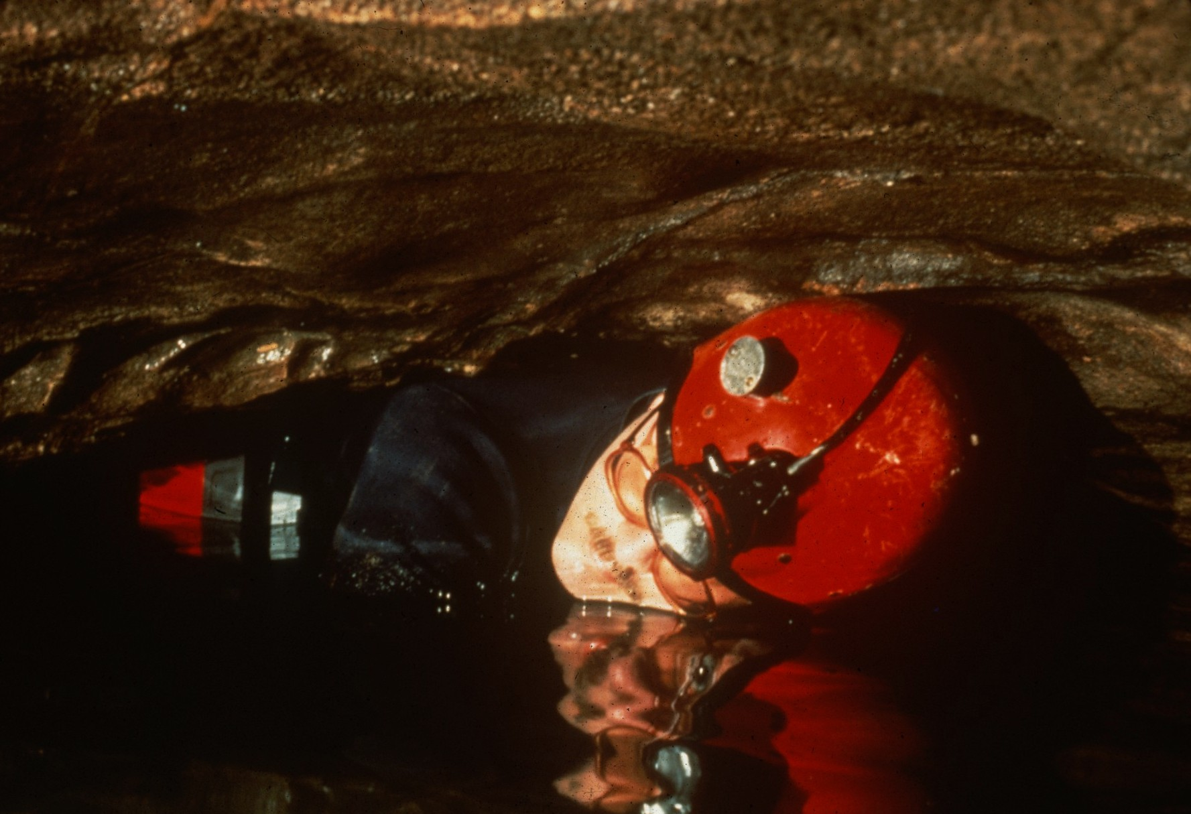
Notes:
Just Tubbin’ For Fun – Scott Fee

Slide 30
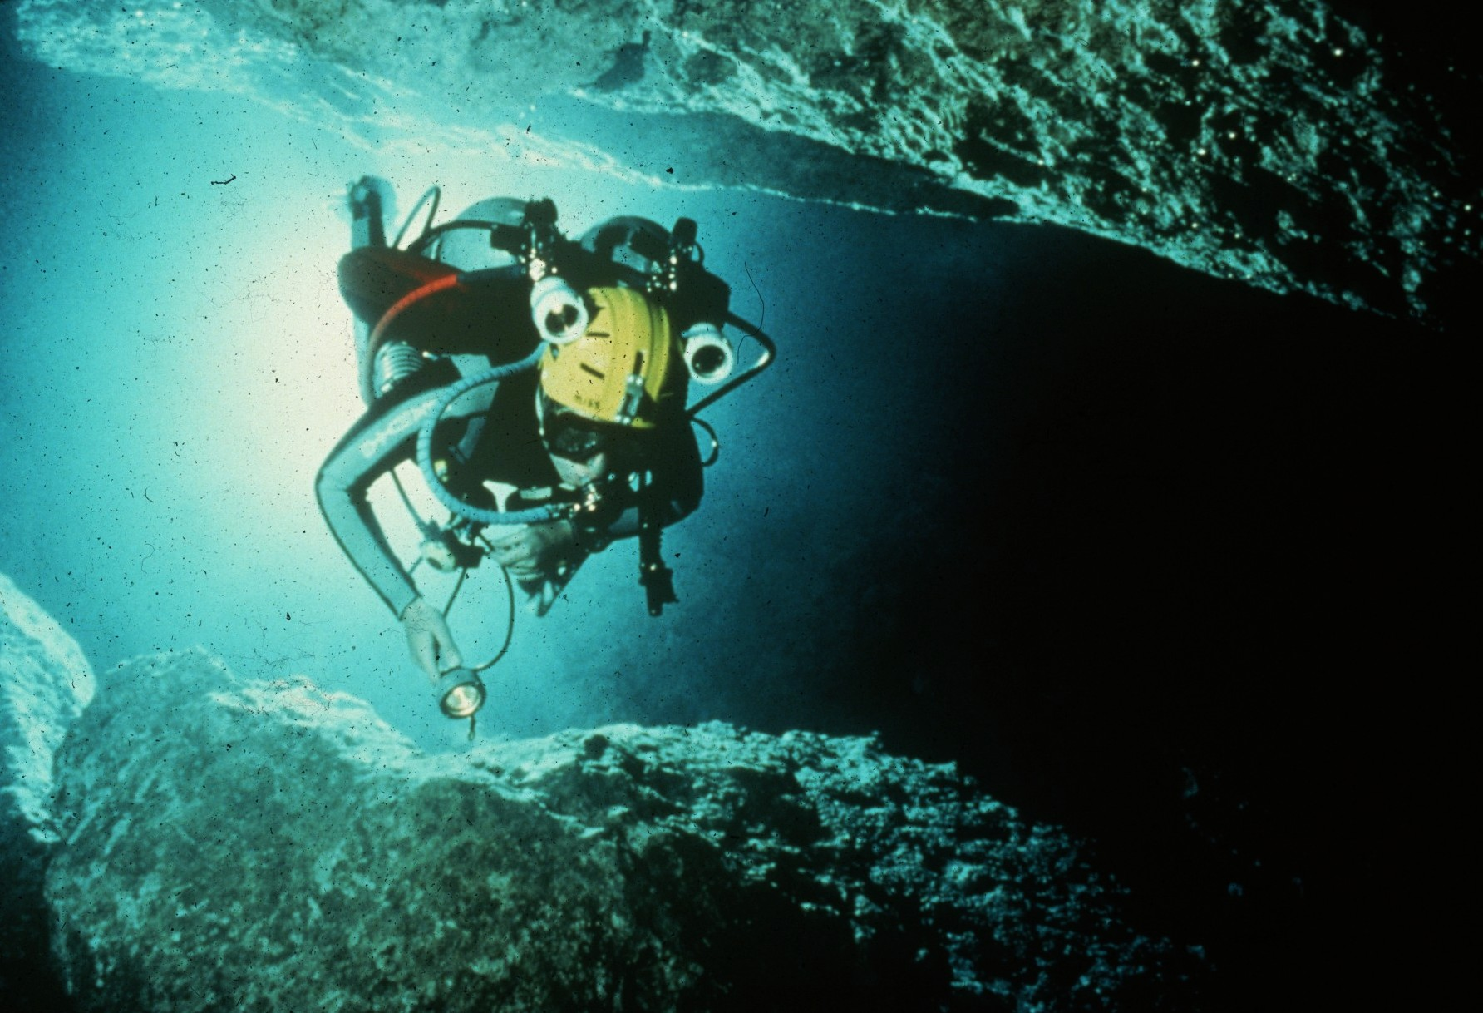
Notes:
Flying – Kevin Downey

Slide 31
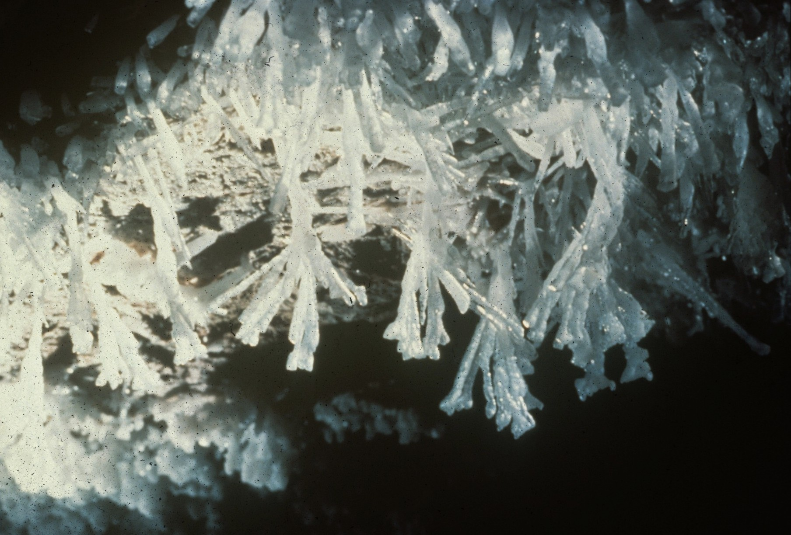
Notes:
Crystal Hands Garden – Kevin Downey, Sura Ballman, and Urs Widmer

Slide 32
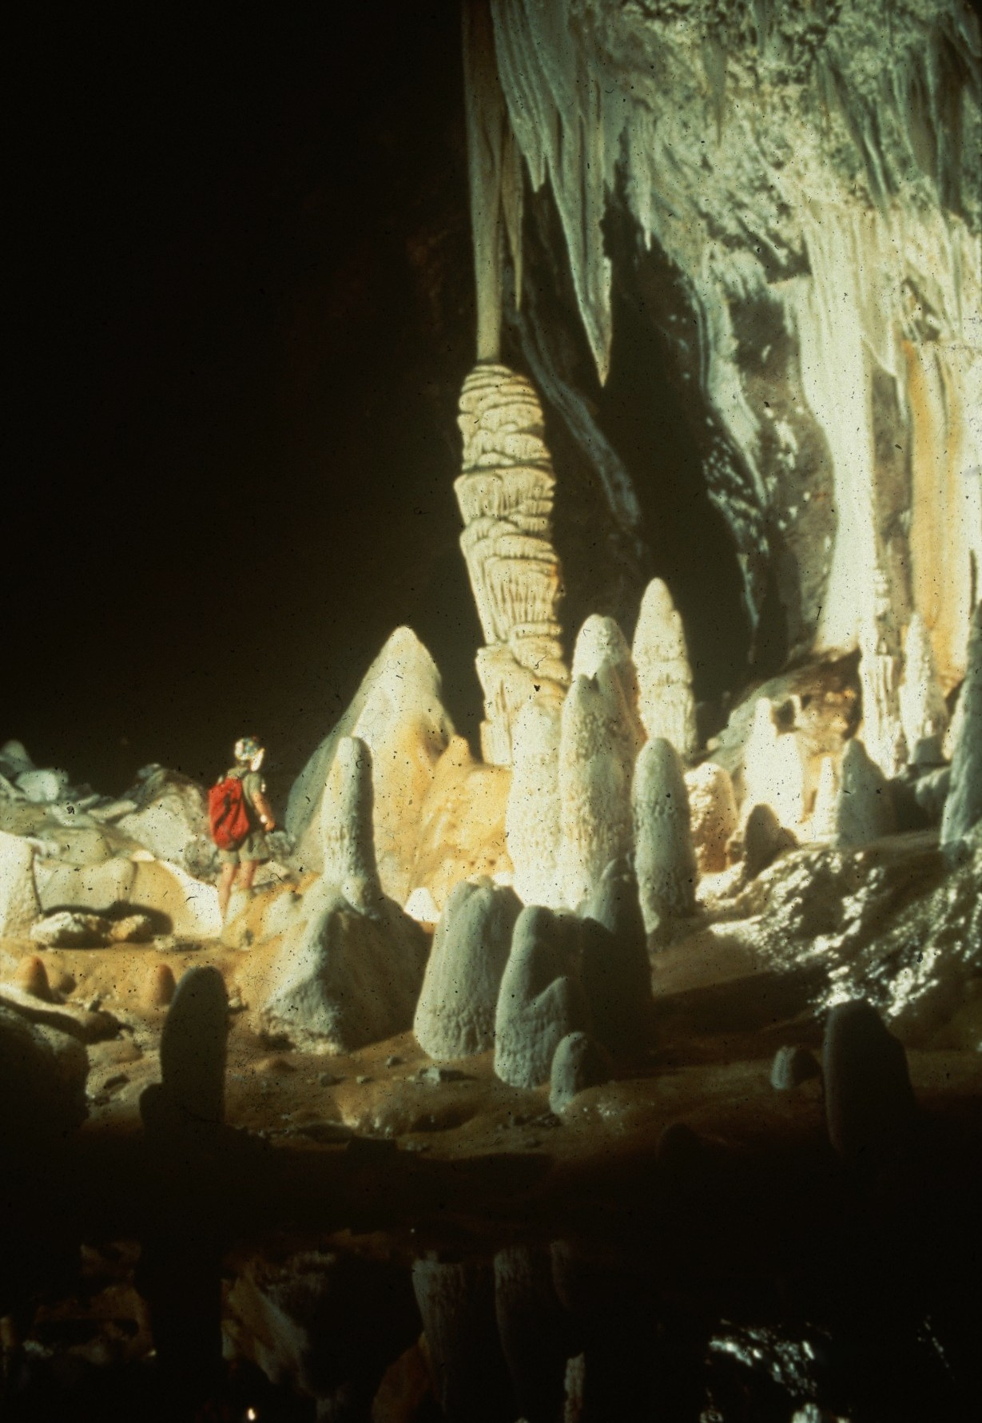
Notes:
In the Gulf – Peter Jones

Slide 33
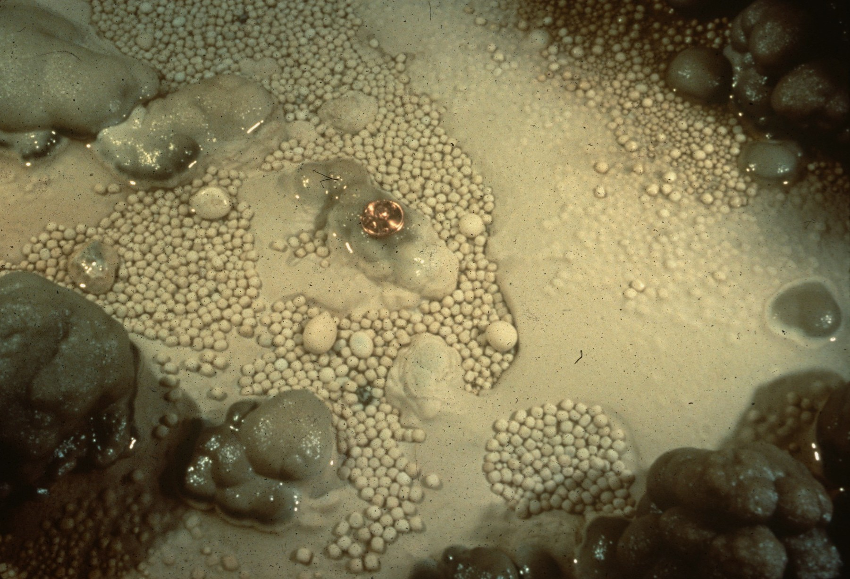
Notes:
Pearl Pool – Ron Simmons

Slide 34
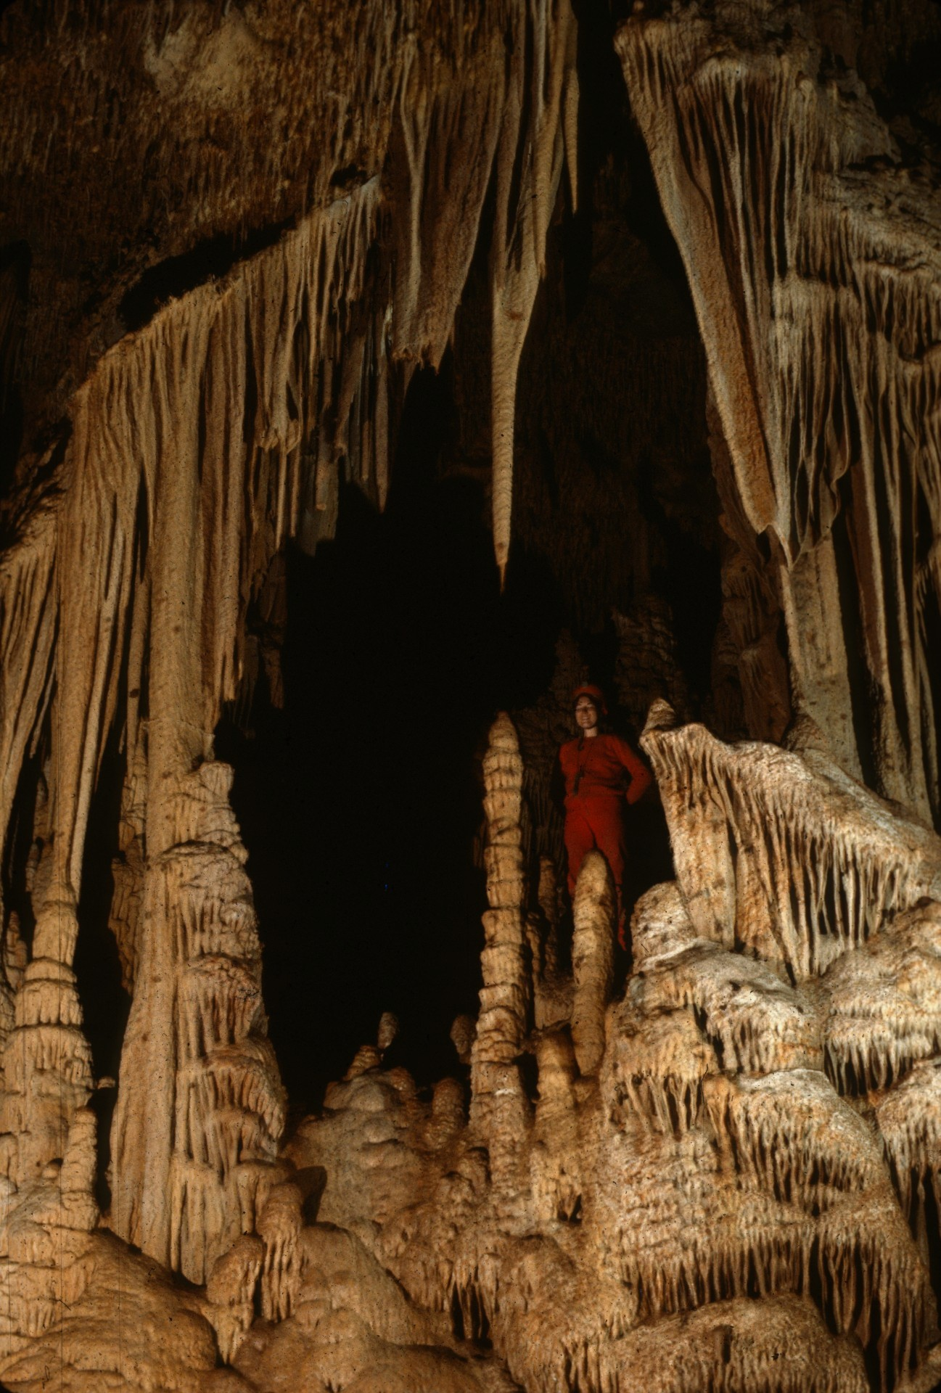
Notes:
Devil’s Dungeon – Jim Loftin

Slide 35
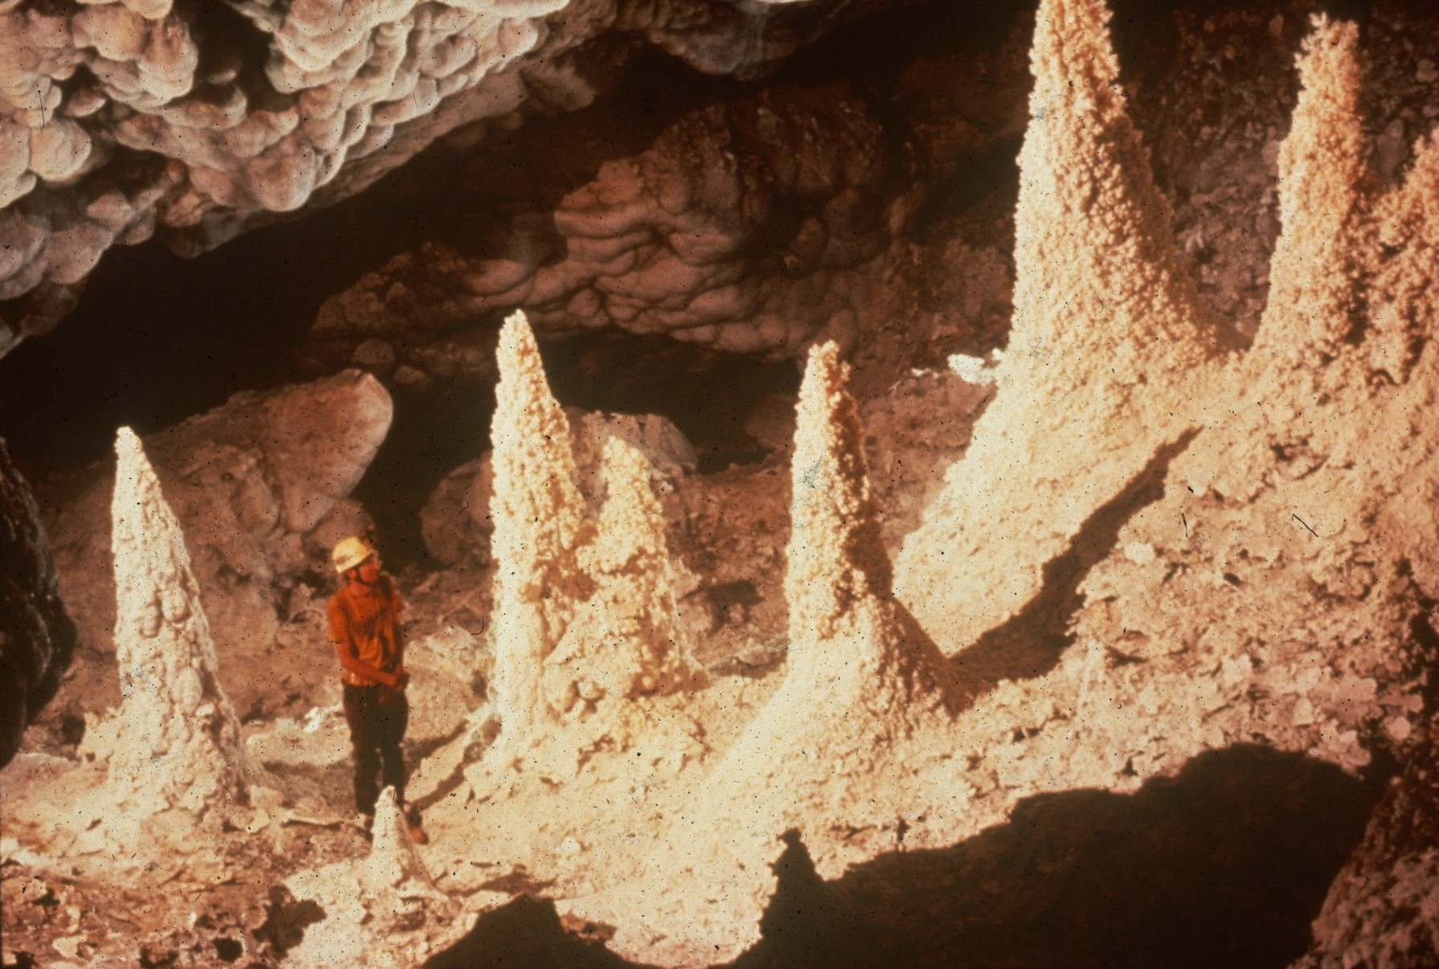
Notes:
Among the Hoodoos – Peter and Ann Bosted

Slide 36
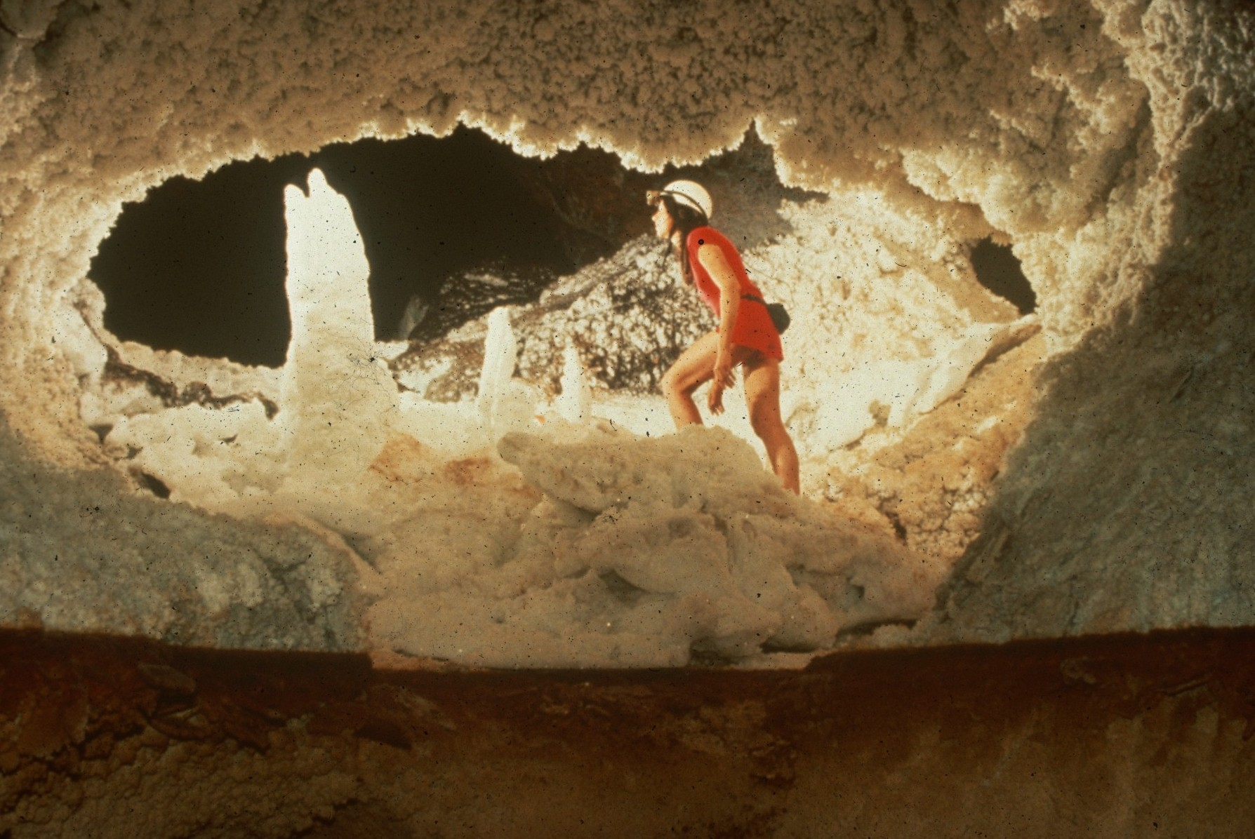
Notes:
Above the Ancient Water-Line – Peter and Ann Bosted

Slide 37
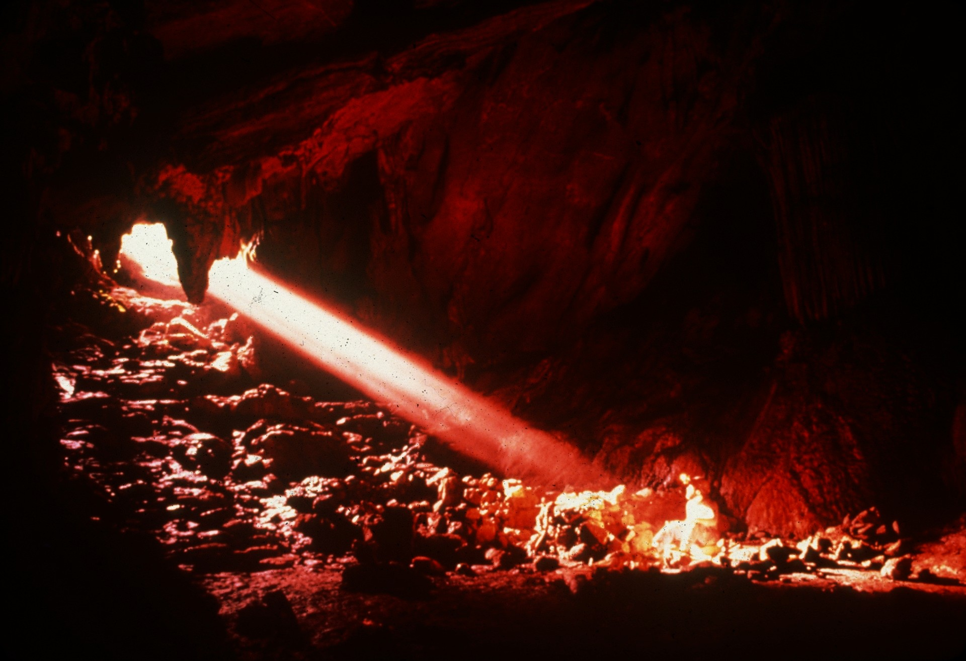
Notes:
Lu Fengyan – Ian Baren

Slide 38
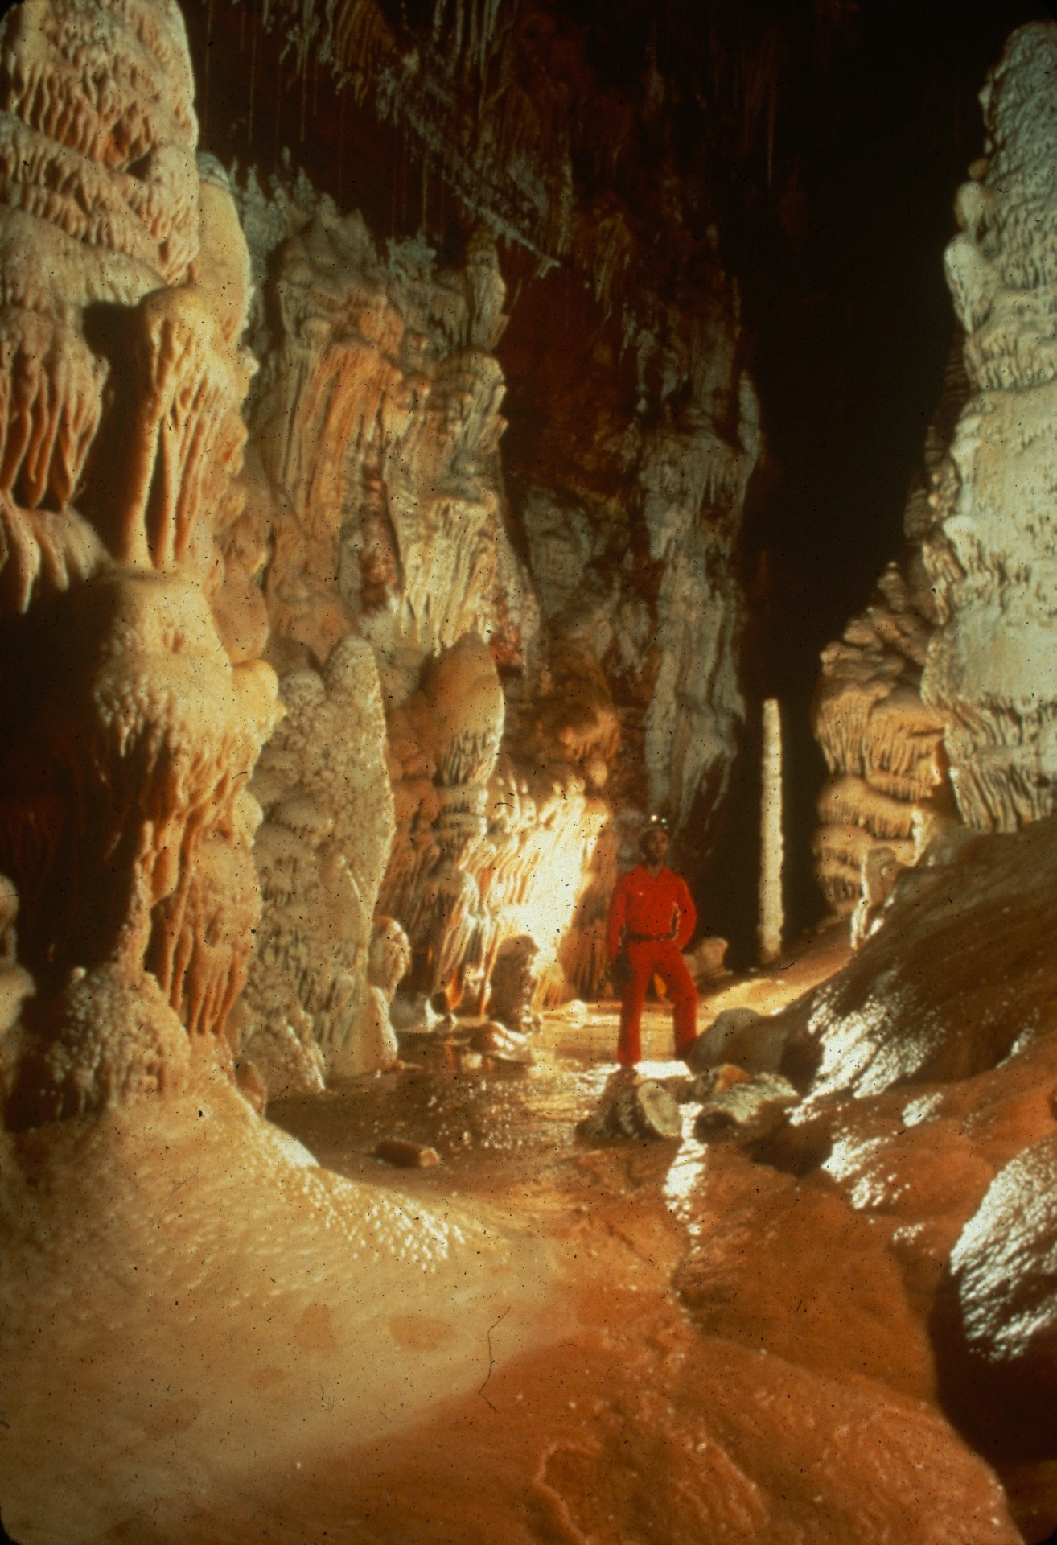
Notes:
Butterscotch Hallway – Kevin Downey, Sura Ballman, and Urs Widmer

Slide 39
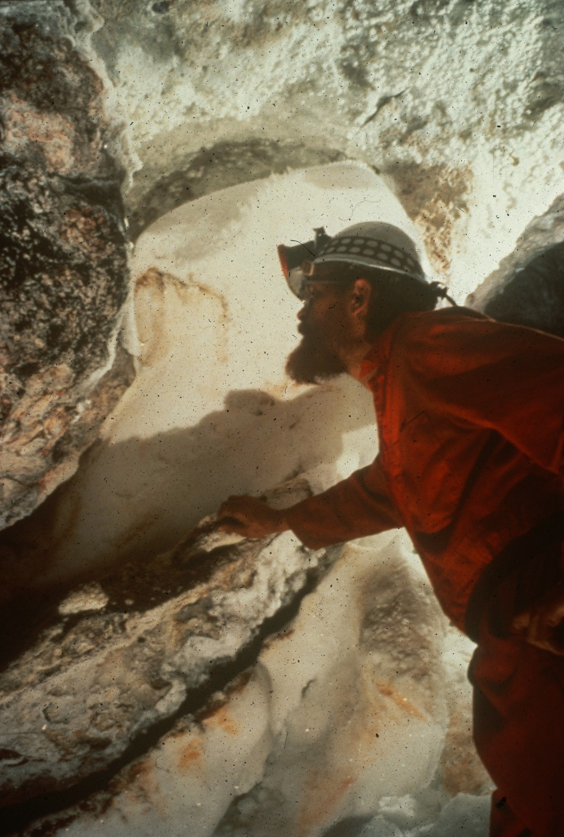
Notes:
Donald in the Ear-otic Zone – Kevin Downey, Sura Ballman, and Urs Widmer

Slide 40
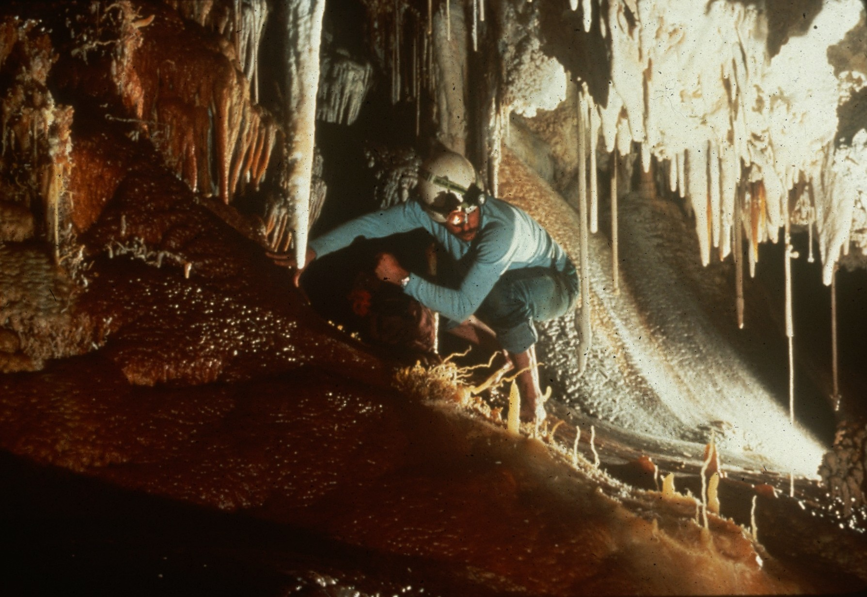
Notes:
A Delicate Move – Peter and Ann Bosted

Slide 41
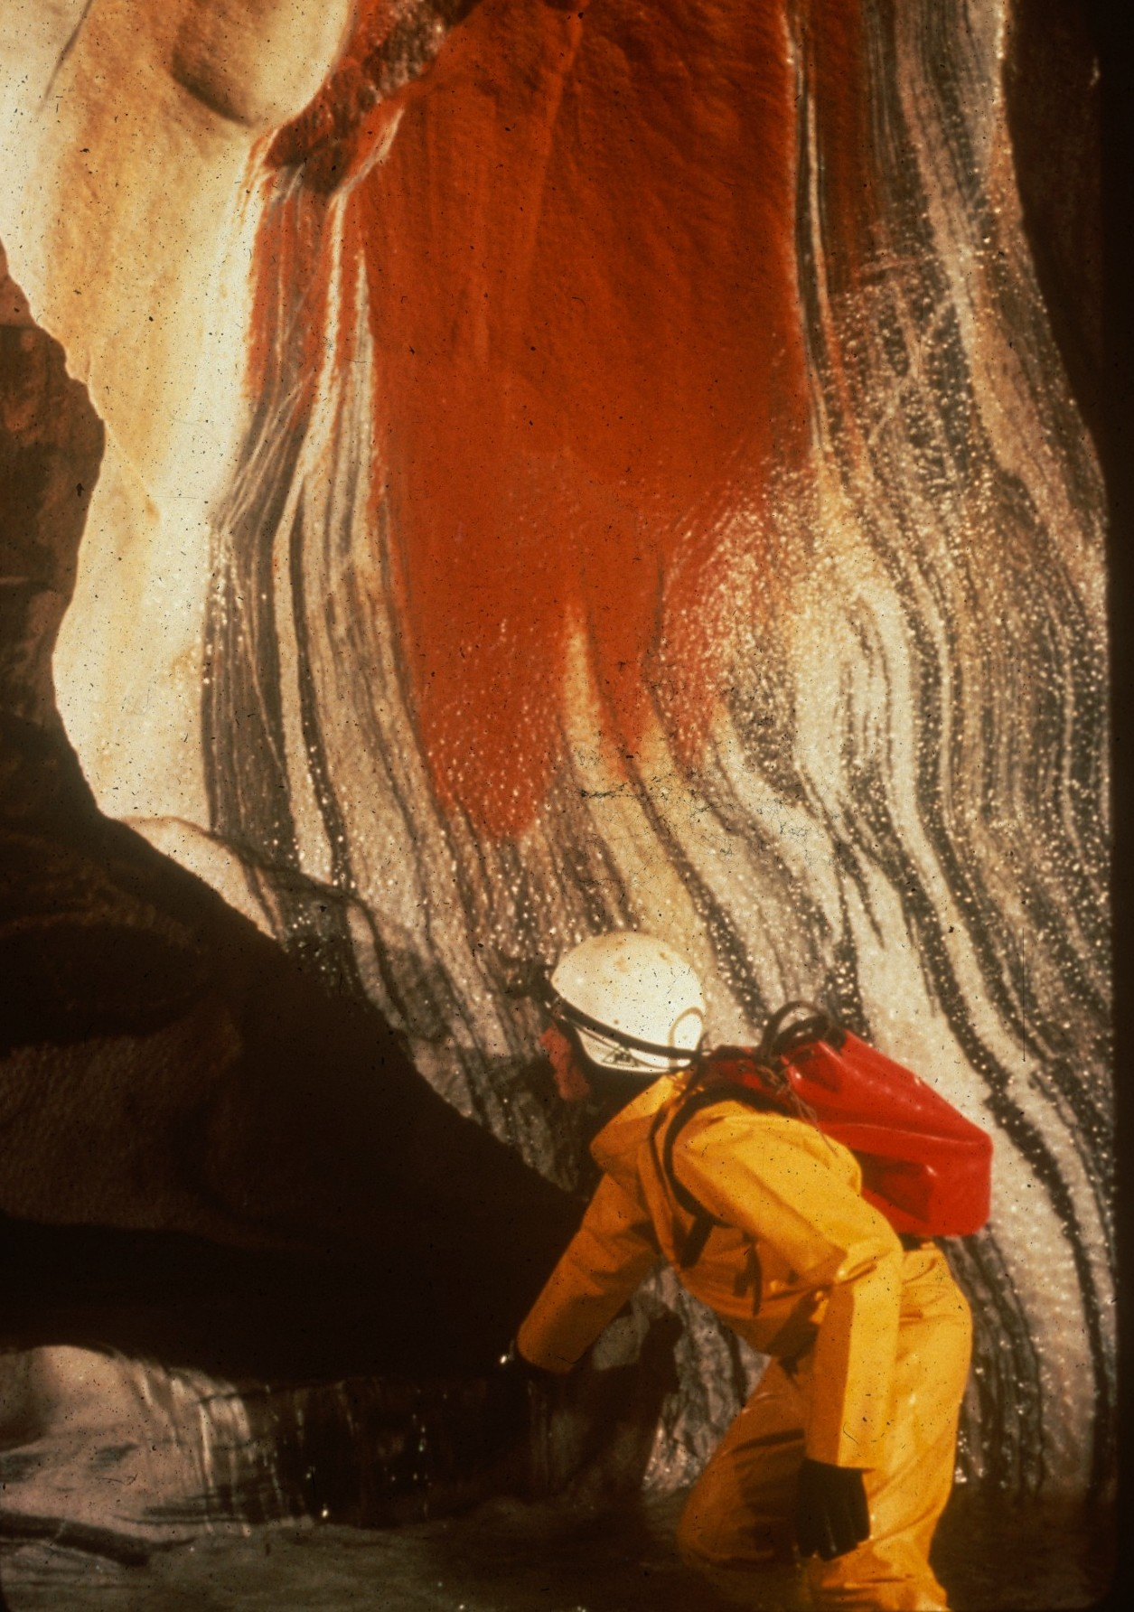
Notes:
Wading Lilburn’s ”Enchanted River” – Peter and Ann Bosted

Slide 42
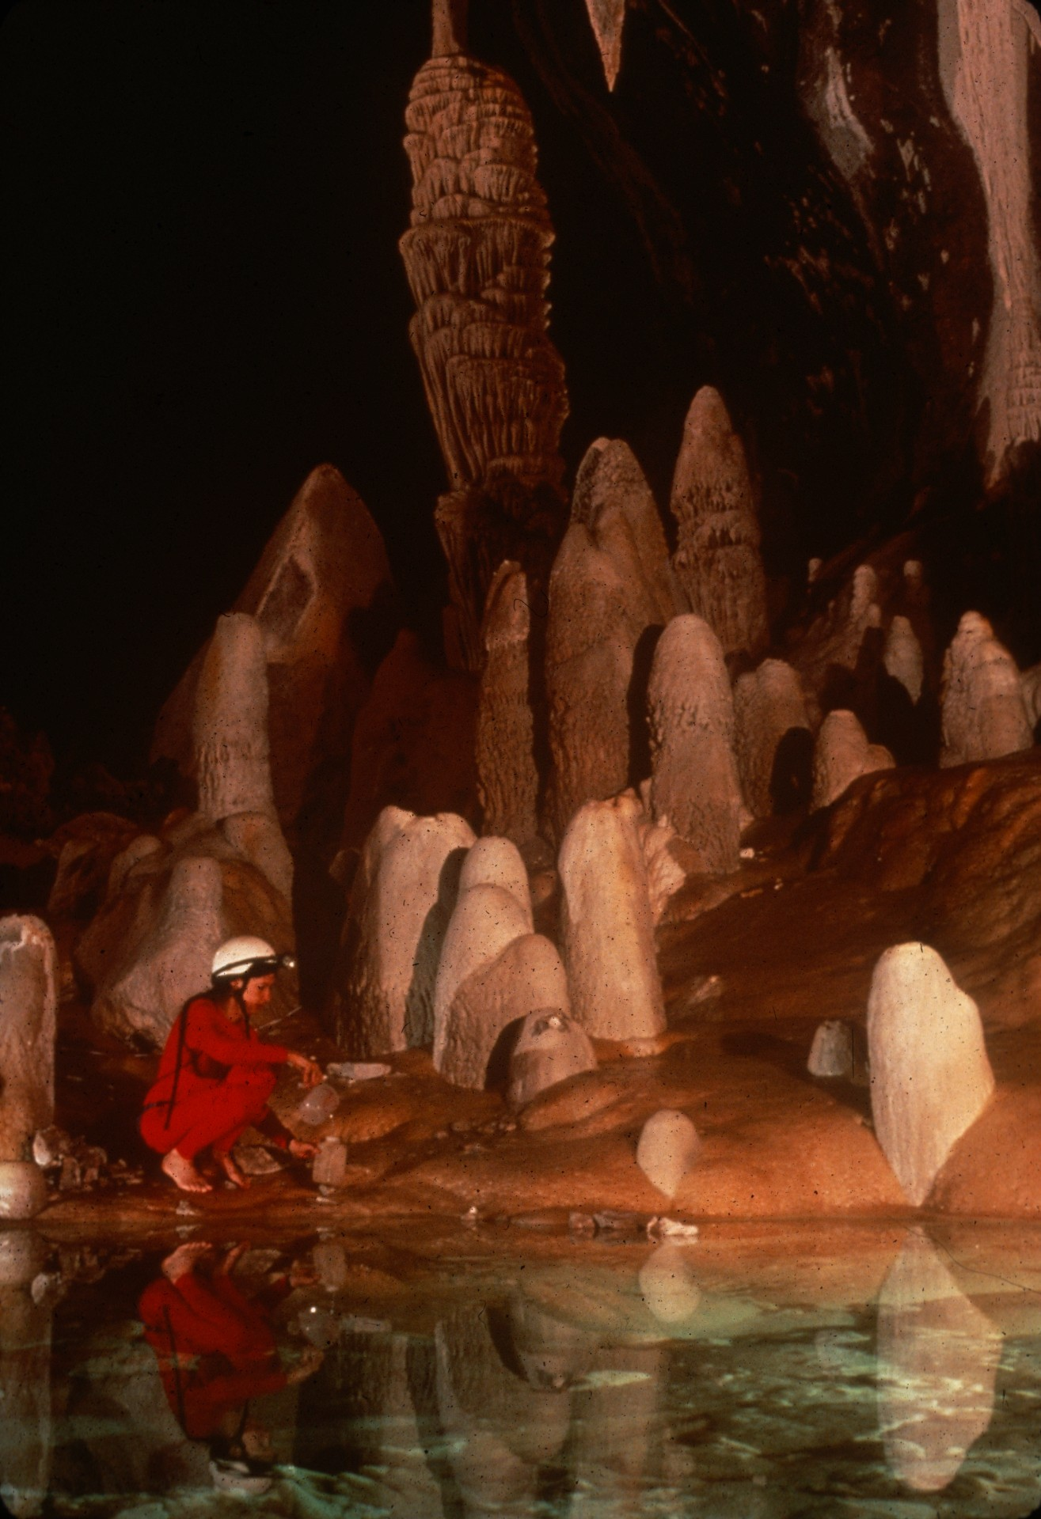
Notes:
A Place for Water – and Inspiration – Peter and Ann Bosted

Slide 43
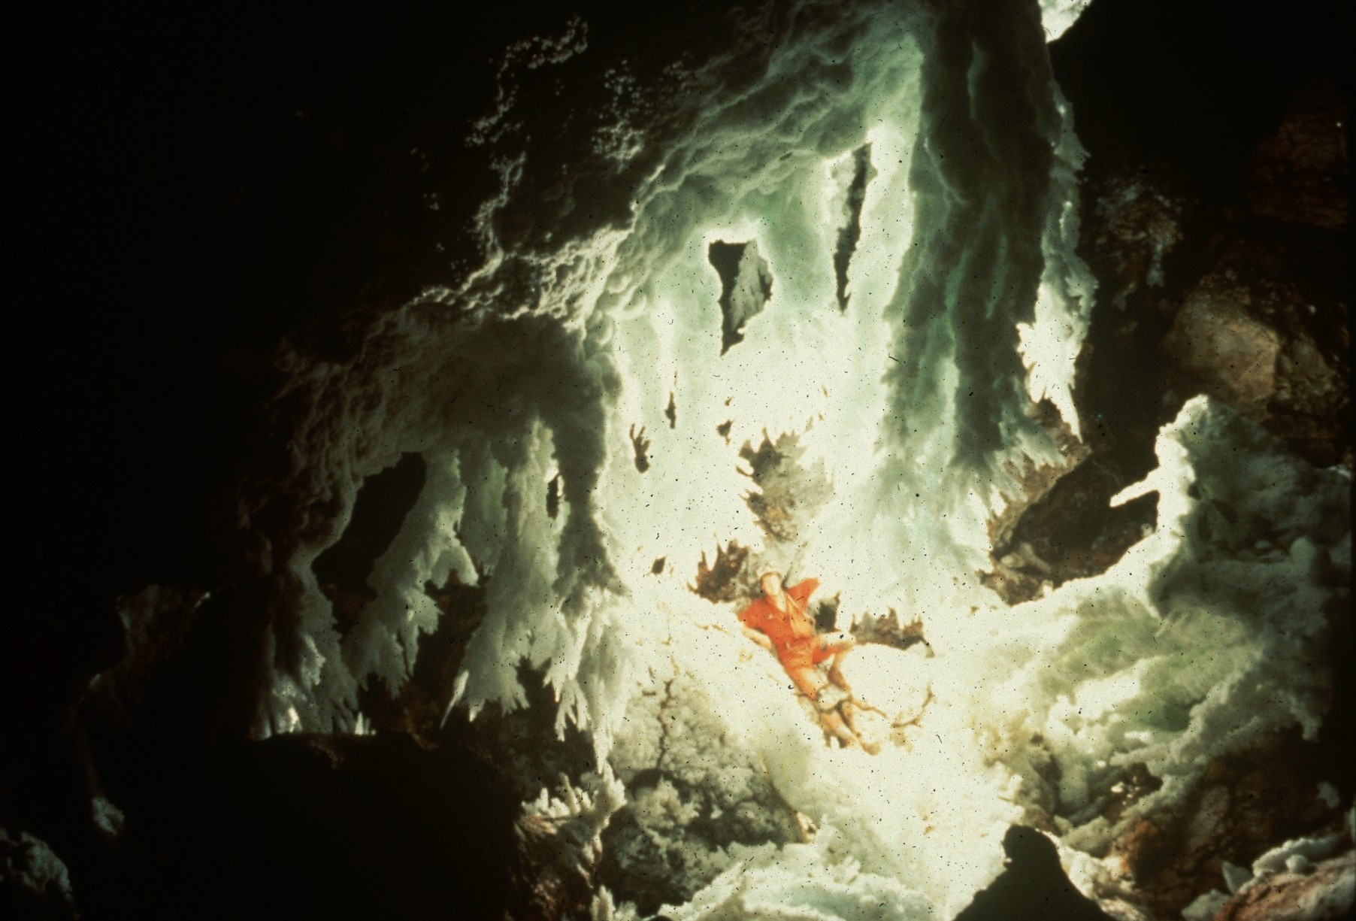
Notes:
Among the Chandeliers – Peter Jones

Slide 44
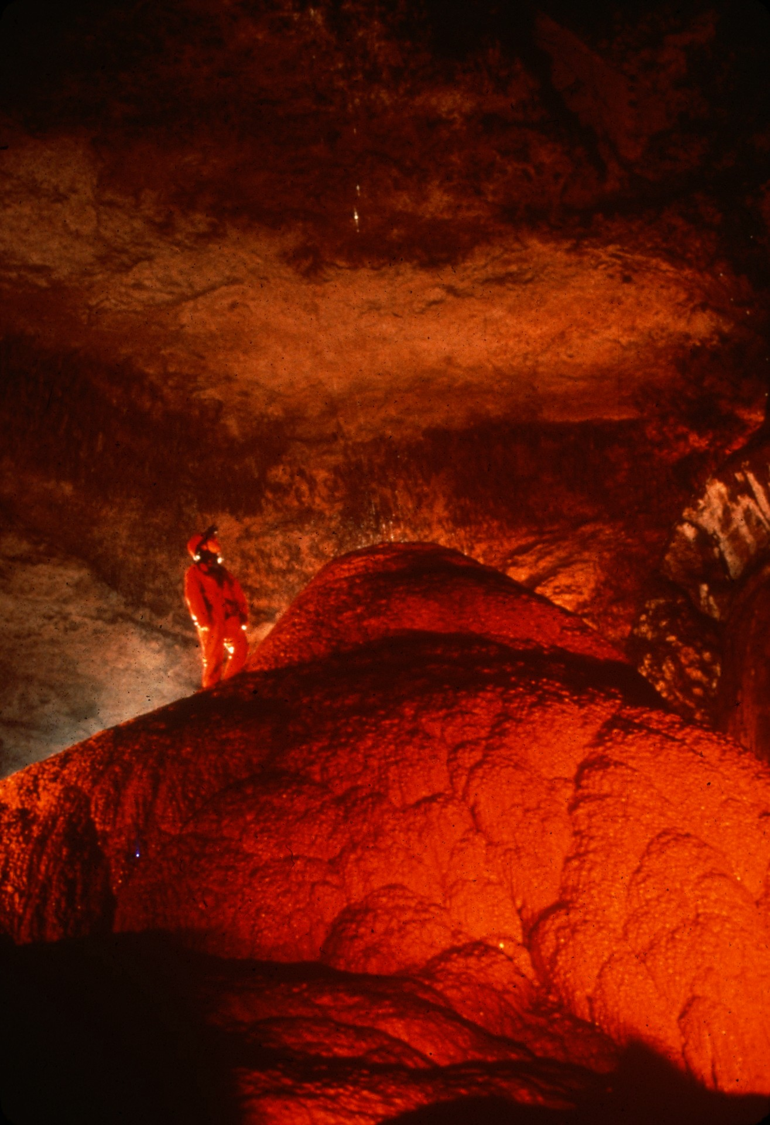
Notes:
Cueva Clara de Empalme, Rio Camuy – Kevin Downey

Slide 45
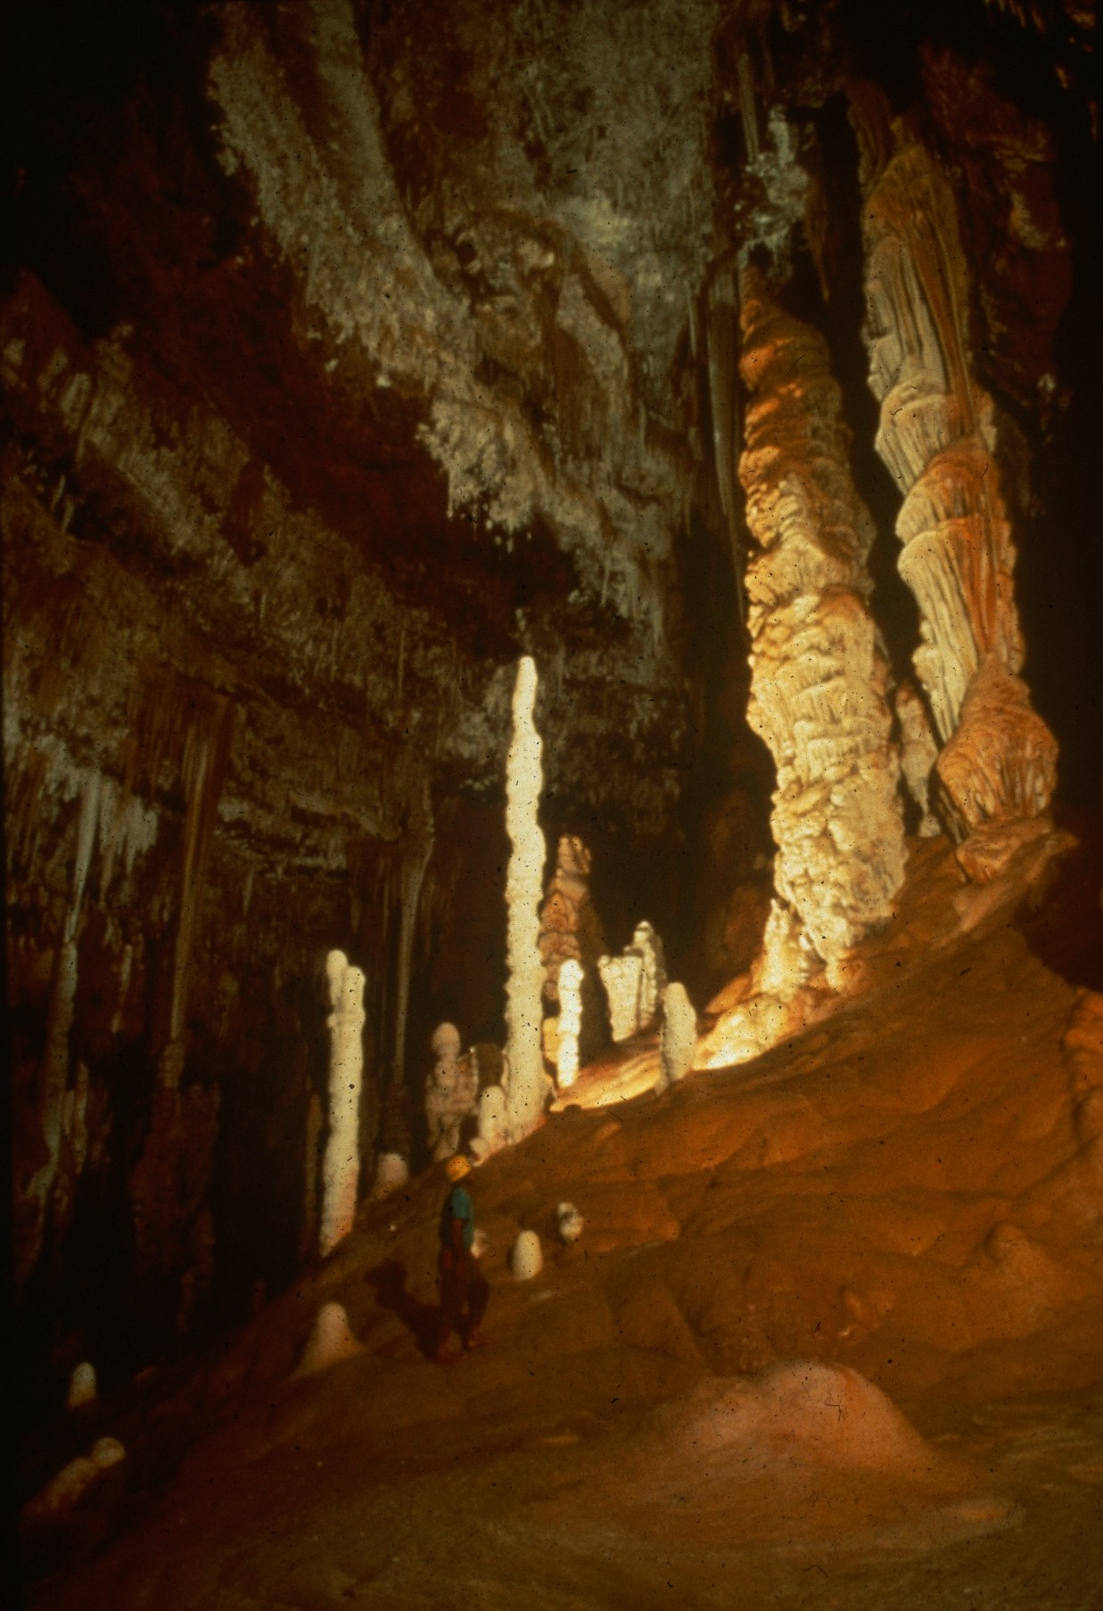
Notes:
Ernie Garza in Tower Place – Norman Thompson

Slide 46
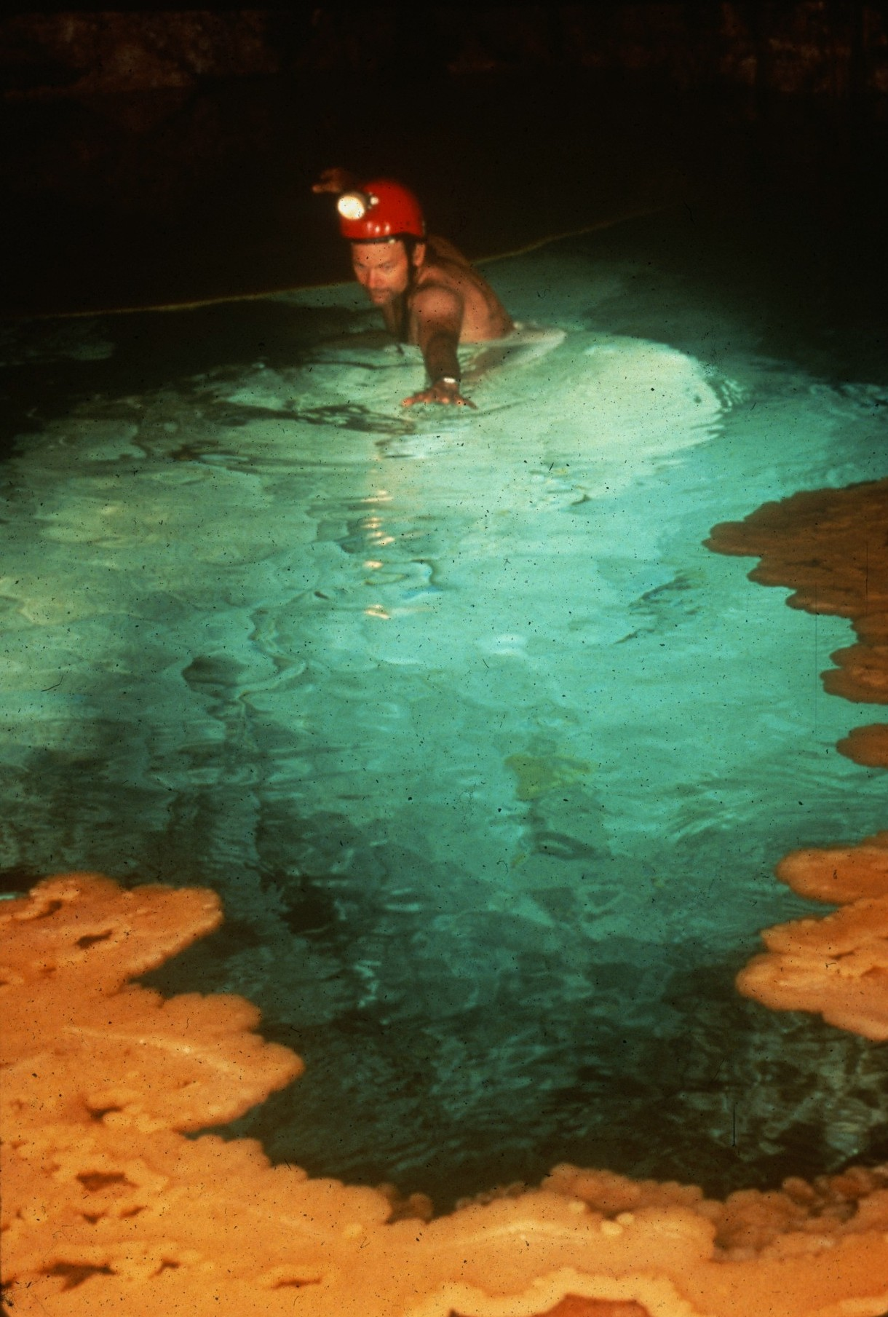
Notes:
Launching for the Lily Pads – Peter and Ann Bosted

Slide 47
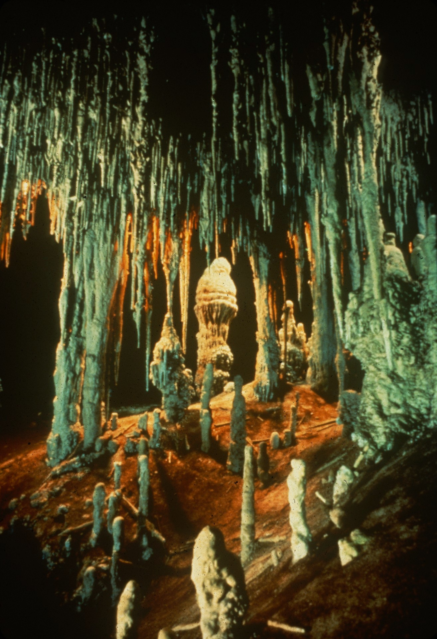
Notes:
Ice Cream Cone – Ron Winiker and Mike Madden

Slide 48
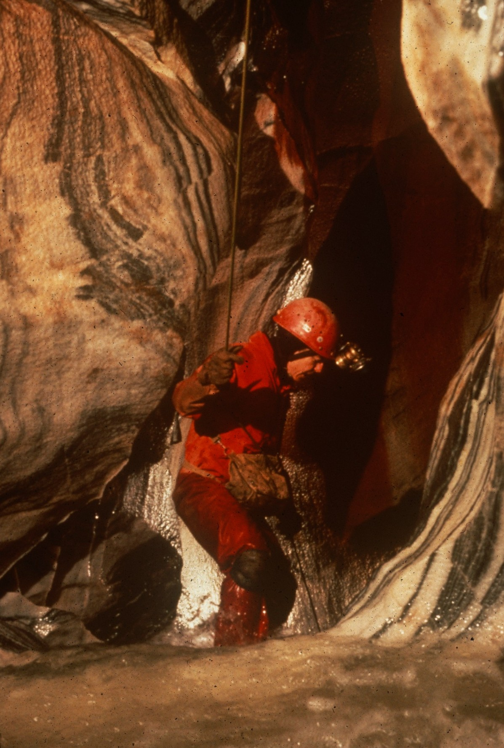
Notes:
Peg Goes With the Flow – Peter and Ann Bosted

Slide 49

HONORABLE MENTION
PHOTO SALON
Notes:
Entries Which Received Honorable Mention – Green Ribbon

Slide 50
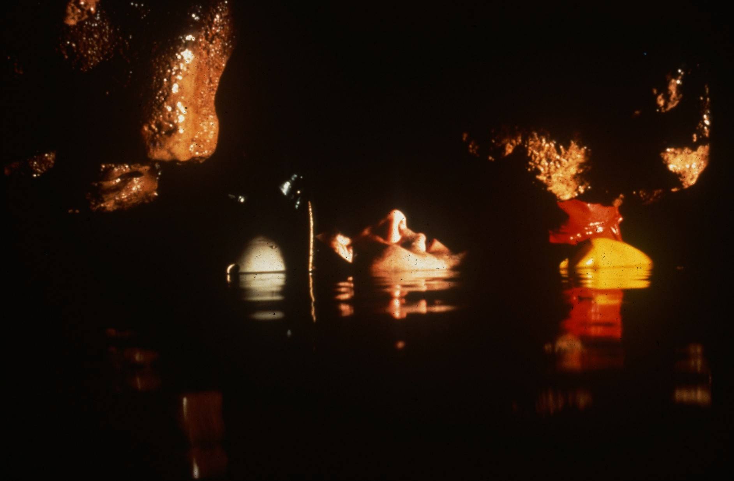
Notes:
Airspace Leads On - Rio Encantado – Kevin Downey

Slide 51
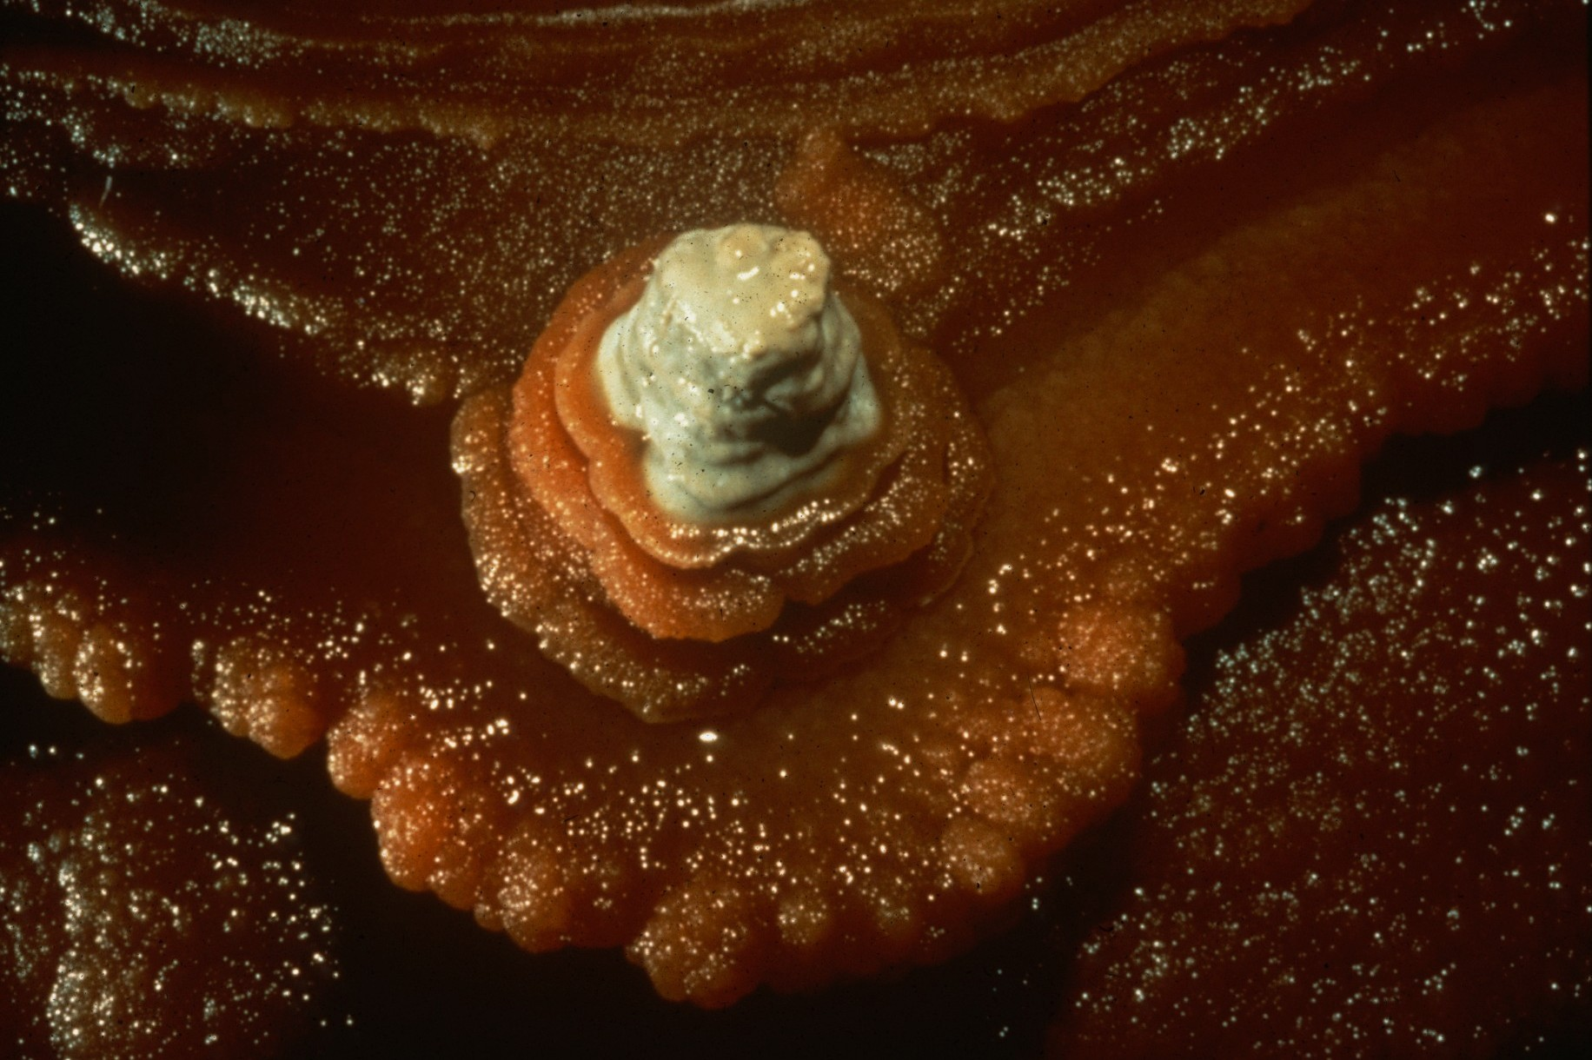
Notes:
Apricot Shelf With Cream Topping – Kevin Downey, Sura Ballman, and Urs Widmer

Slide 52
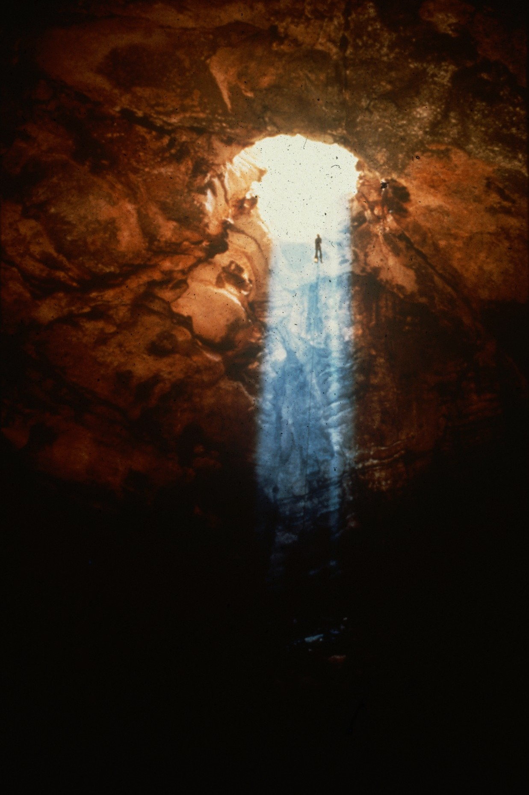
Notes:
Climbing Up the Light – Kevin Downey

Slide 53

Notes:
True Beauty and a False Floor – Peter and Add Bosted

Slide 54

Notes:
Velvet Magic – Kevin Downey, Sura Ballman, and Urs Widmer

Slide 55

Notes:
Nohoch Azul Columns – Ron Winiker and Mike Madden

Slide 56

Notes:
Rillen Karren of the Far East Maze – Kevin Downey, Sura Ballman, and Urs Widmer

Slide 57

Notes:
All Dried Up – Jim Loftin

Slide 58

Notes:
Da Tiedong – Ian Baren

Slide 59

Notes:
Dripstone II – Ron Simmons

Slide 60

Notes:
Ben’s Slot – Ron Simmons

Slide 61

Notes:
Caver Wash – Ron Simmons

Slide 62

Notes:
The Centerpiece – Peter and Ann Bosted

Slide 63

Notes:
Nine Minutes From Underground Atlanta – David Harris

Slide 64

Notes:
Camp Martatick – Jamaica Cockpits – Ed Devine

Slide 65

Notes:
Rimstone Reminance – John Van Swearingen, IV

Slide 66

MERIT AWARD
PHOTO SALON
Notes:
Entries Which Received Merit Award – Blue Ribbon

Slide 67

Notes:
Filamental Helictites – Norman Thompson

Slide 68

Notes:
Above and Below Water – Kento Gabo On a Lily Pad – Norman Thompson

Slide 69

Notes:
Perfect Tree – Kevin Downey, Sura Ballman, and Urs Widmer

Slide 70

Notes:
Filamental Helictite and Soda Straw – Norman Thompson

Slide 71

Notes:
Trenton Well – Jim Loftin

Slide 72

Notes:
Trendils – Ron Simmons

Slide 73

Notes:
The Amazing Giant Snowflake – Kevin Downey, Sura Ballman, and Urs Widmer

Slide 74

Notes:
Points to Ponder – Peter and Ann Bosted

Slide 75

Notes:
Where Eagles Dare – John Van Swearingen, IV

Slide 76
BEST OF SHOW
PHOTO SALON
Notes:
Entry Selected as Best of Show – Medal Award

Slide 77

Notes:
Up the Drill Hole – Kevin Downey, Sura Ballman, and Urs Widmer

Slide 78
Photographers
Notes:
Photographers

Slide 79
Photographers:
  Sura Ballman
  Ian Baren
  Peter and Ann Bosted
  Roland Browne
  Ed Devine
  Kevin Downey
  Scott Fee
  David Harris

Slide 80
Photographers:
  Peter Jones
  Jim Loftin
  Mike Madden
  Ron Simmons
  John Van Swearingen, IV
  Norman Thompson
  Urs Widmer
  Ron Winiker

Slide 81

An NSS Audio-Visual Library Presentation
The Best of the
1991 NSS Photo Salon
Original slide program S914
Slides digitized by David Caudle
PowerPoint program created by Jim McConkey
81 slides, with script in presenter notes
PowerPoint created 2/23/2021
National Speleological Society
6001 Pulaski Pike
Huntsville, AL 35810-1122
256- 852-1300
nss@caves.org
https://caves.org/

